Slide 1
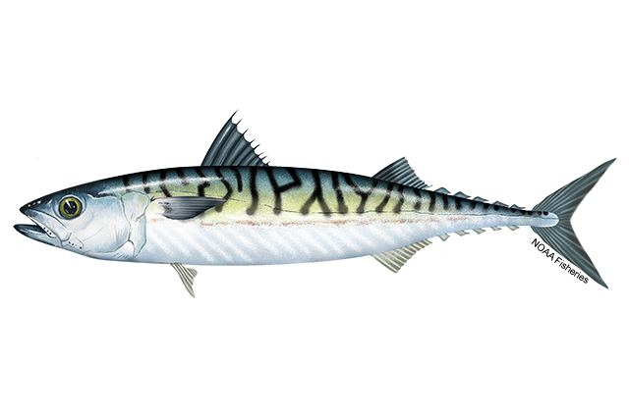

ToR 5: Atlantic mackerel
Kiersten Curti & Alex Hansell
Working paper 10
2/09/24

Slide 2
Assessment Timeline
Last benchmark 2017
Last management track 2023
State-space research track 2024
Next management track 2025

Slide 3
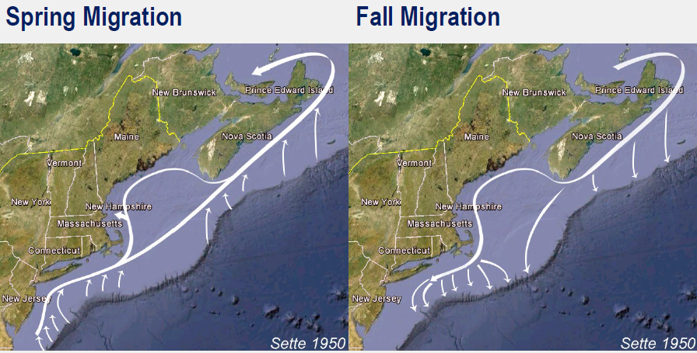
Background
Two spawning contingents that migrate seasonally and mix on the NE US Shelf during winter months
Previous assessments have struggled with poor diagnostics
Currently accepted ASAP model exhibits a poor fit to the NEFSC trawl survey Albatross index, retrospective patterning, and poor projection performance
During the most recent (2023) management track assessment, the review panel recommended development of a state-space model to better deal with process error and changing ecosystems
Notes:
Contingents: one that spawns in the southern Gulf of St Lawrence primarily during July and another that spawns primarily in southern New England in May/June. Atlantic mackerel migrate seasonally and during winter months, the two contingents mix on the Northeast U.S. shelf and are available to the U.S. fishery.
Poor diagnostic issues included convergence issues and inability for model to resolve trends in disparate data sources, highly correlated residuals, potential non-linear relationship between the NEFSC trawl survey and stock abundance, strong retrospective patterning,
Current ASAP model was accepted during the 2017 benchmark, and while it made a huge advance with development of an egg index to resolve conflicting trends between the survey and fishery data sets, it exhibited a poor fit to the Albatross index. Additionally, subsequent management tracks have shown increased residual patterning and very poor projection performance where the estimated recruitment has not materialized into SSB

Slide 4
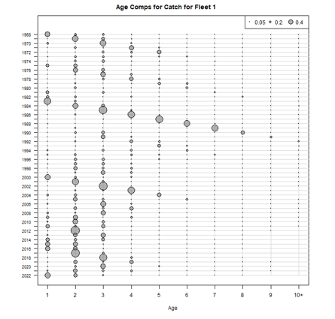
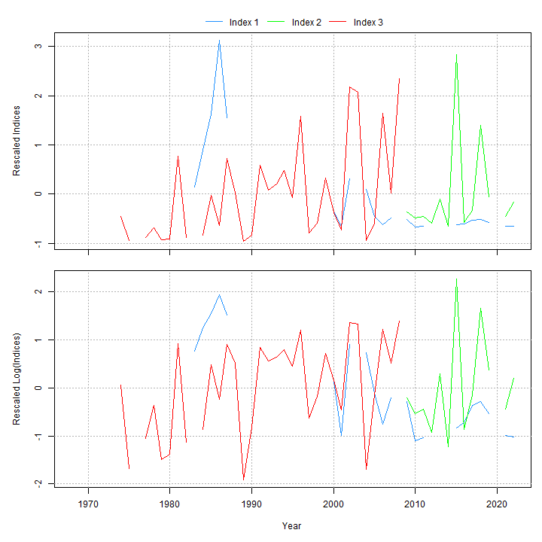
Data inputs
Ages 1-10+
Fishery catch (1968-2022, one fleet)
Surveys:
Egg survey (1983-2022)
NEFSC spring (Albatross 1974-2008; ages 3+)
NEFSC spring (Bigelow 2009-2022 ; ages 3+)
Natural mortality = 0.2
Age Structured Assessment Program (ASAP)

Slide 5
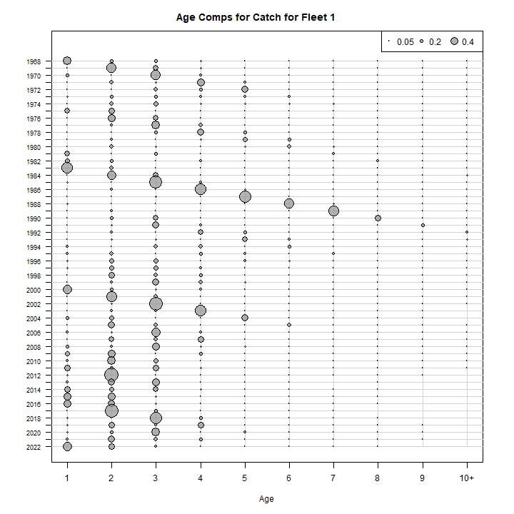
Fishery catch
Figure 1 WP 10

Slide 6
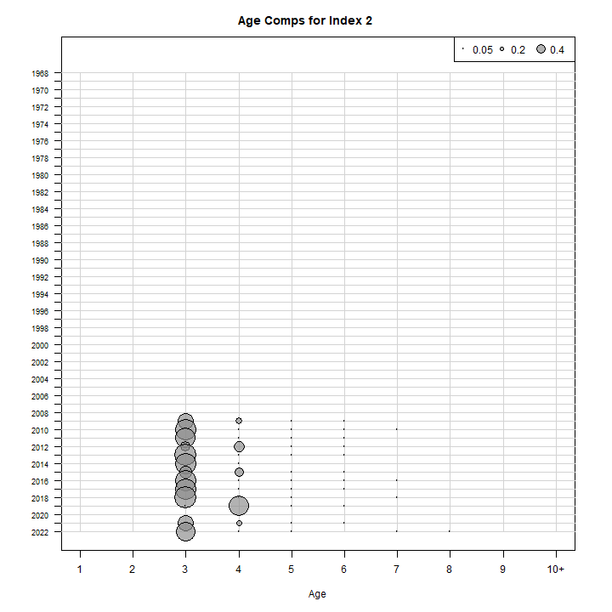
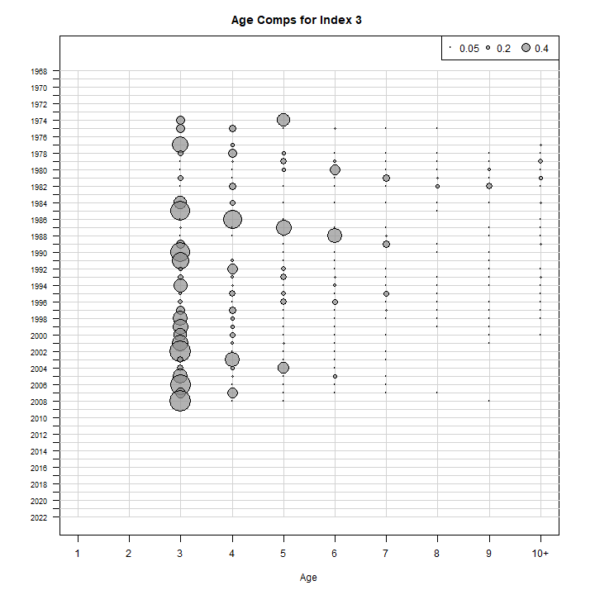
Survey indices
Index 1 = Egg index (blue)
Index 2 = Bigelow (green)
Index 3 = Albatross (red)
Figure 2 WP 10
Figure 3 WP 10

Slide 7

The plan
ASAP → WHAM
Age-comps
Recruitment
Time varying
Selectivity
NAA

Slide 8
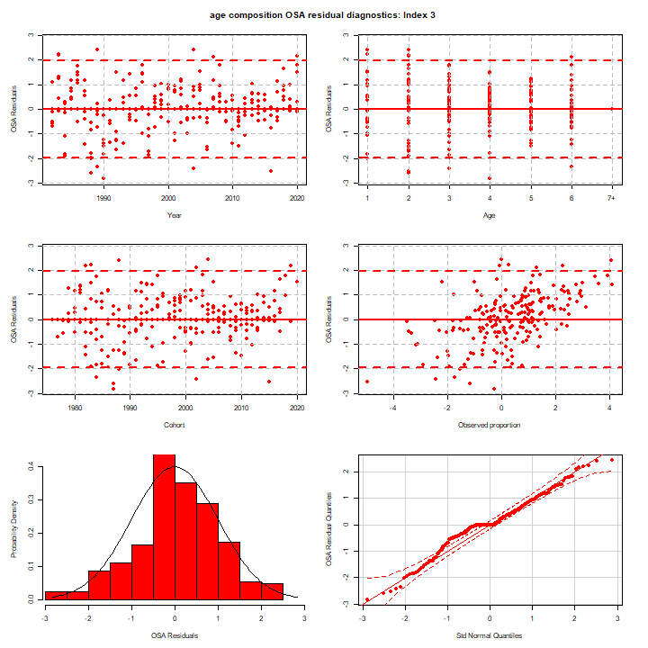
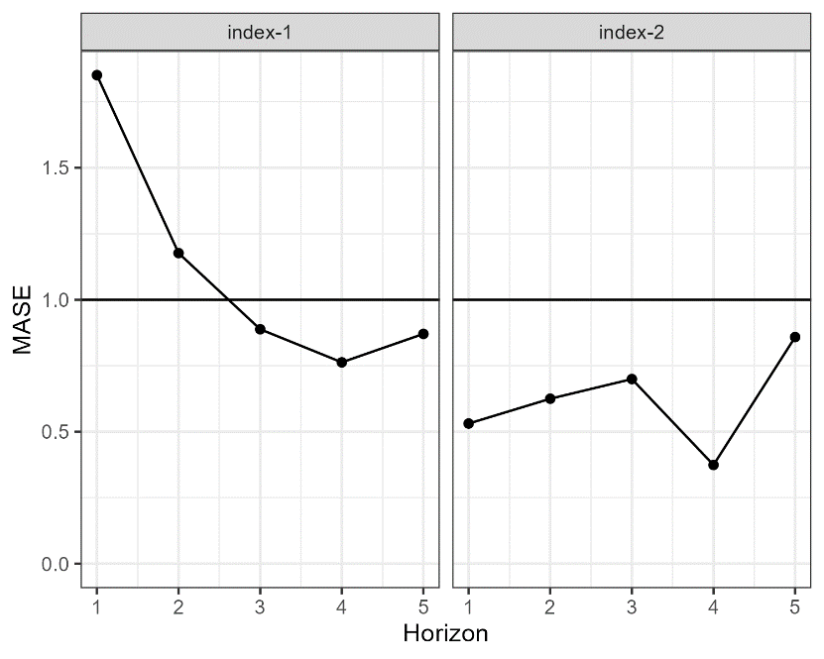
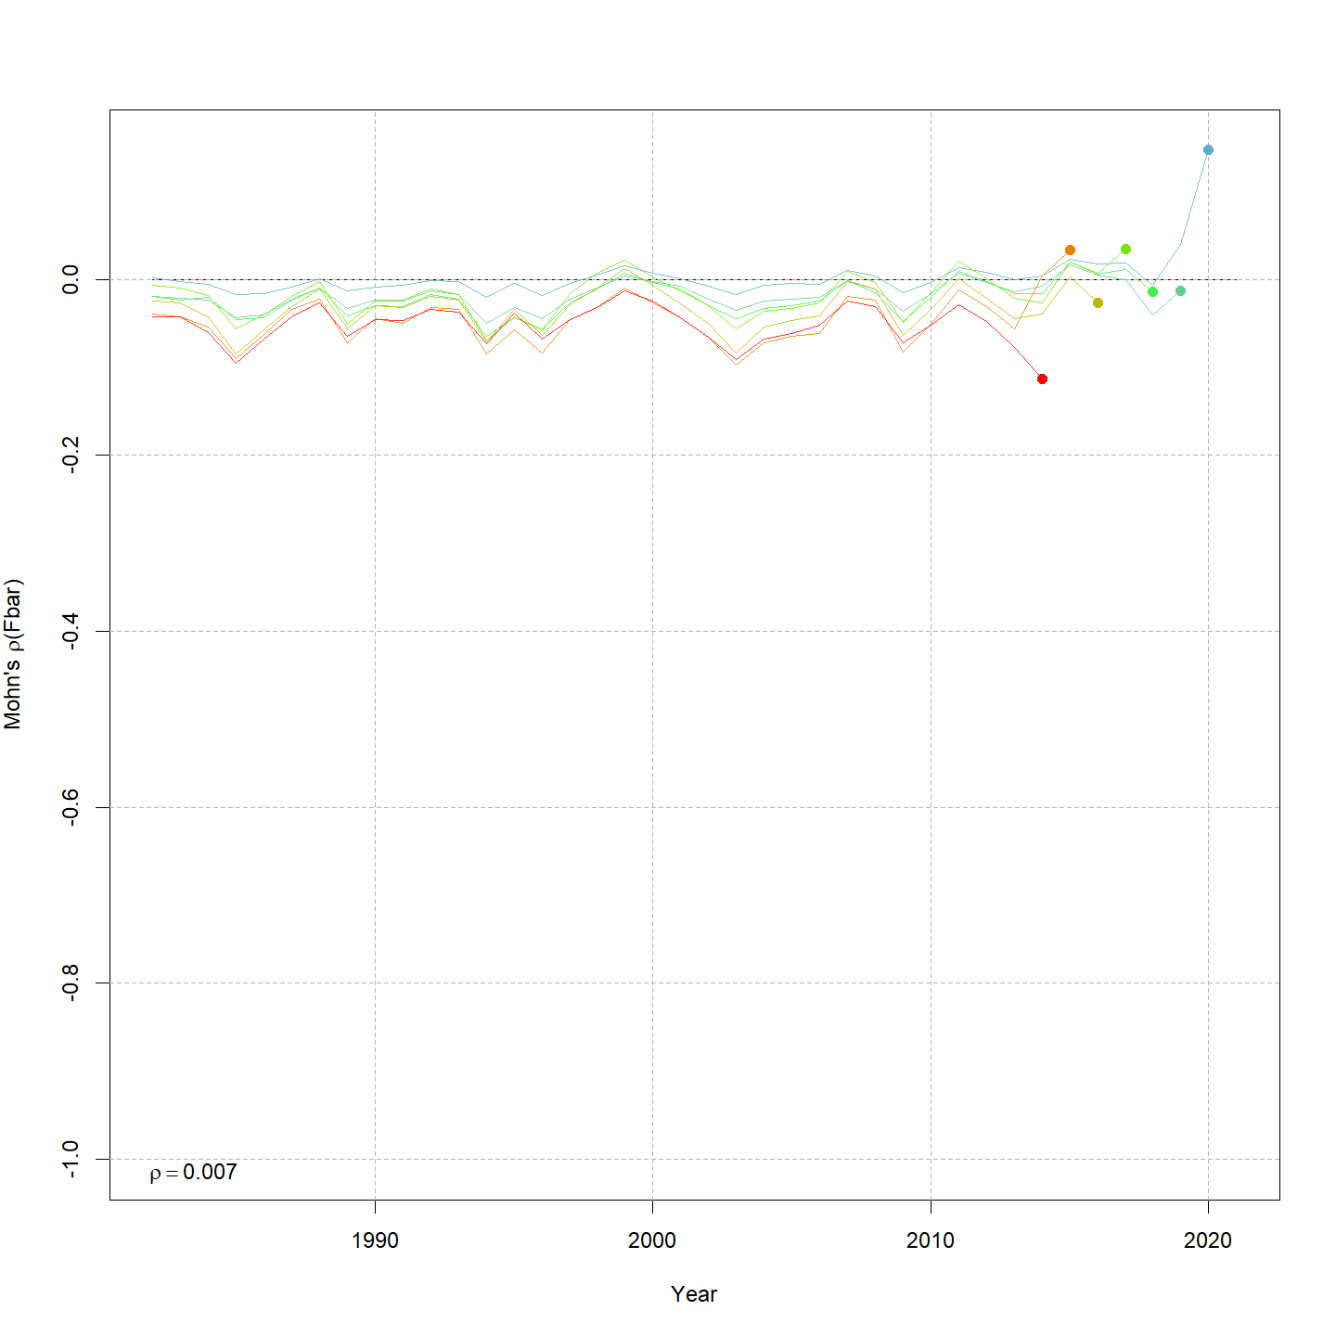
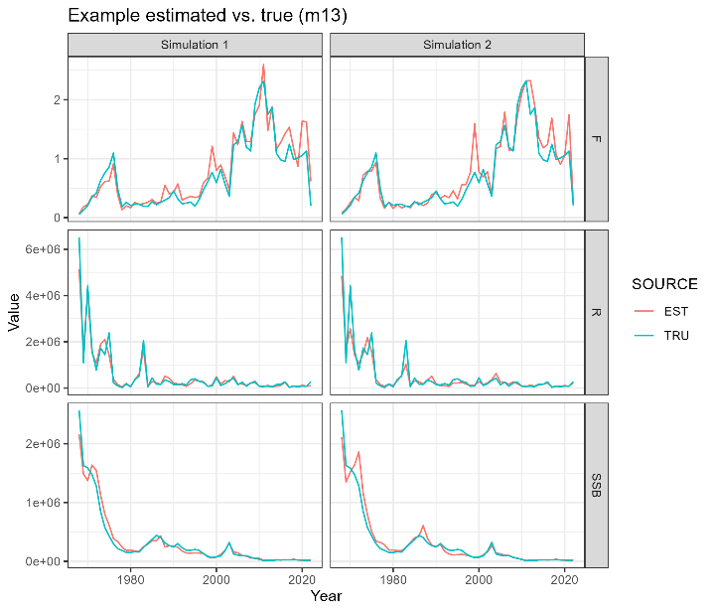
Diagnostics
1) Convergence
2) Residuals
3) AIC
4) Retrospective patterns
5) Prediction skill
6) Estimation performance
7) Plausibility

Slide 9
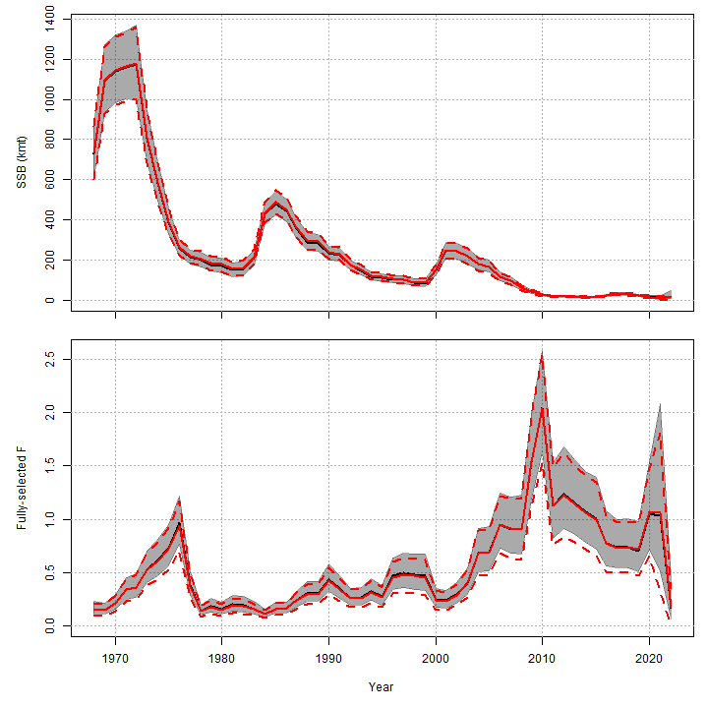
ASAP to WHAM
ASAP
WHAM
Figure 4 WP 10

Slide 10
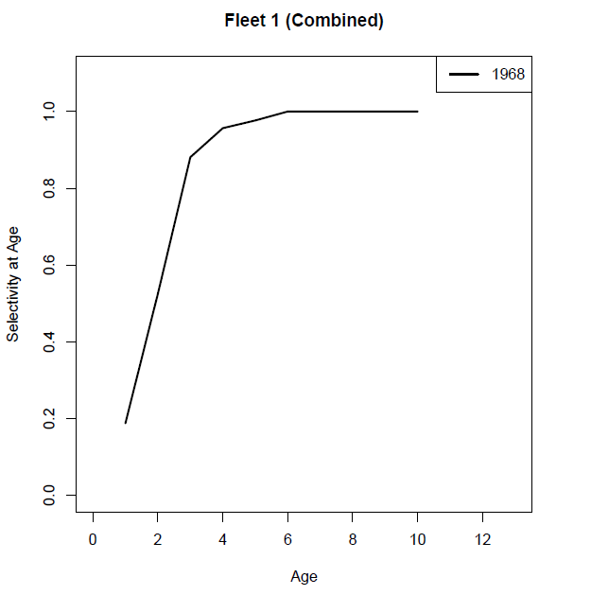
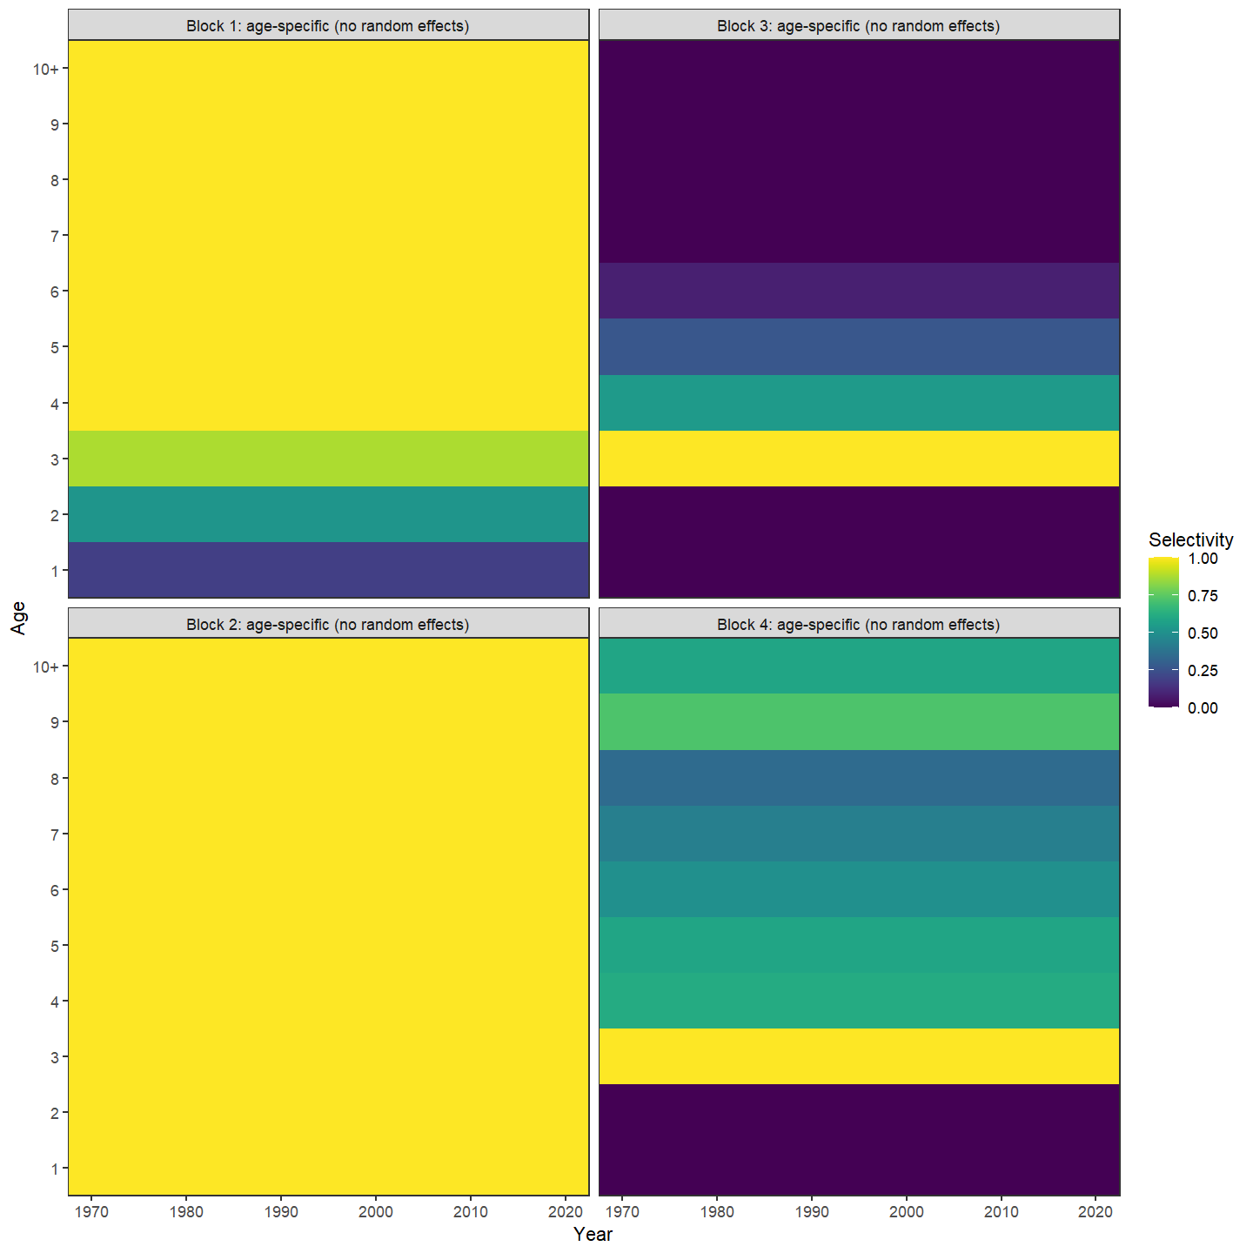
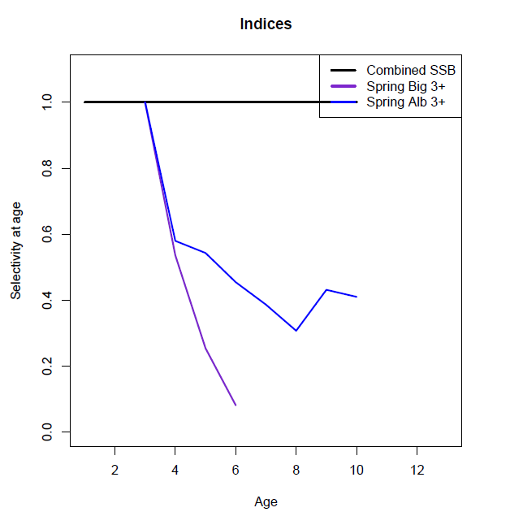
Selectivity
Block 1 = Catch
Block 2 = Egg index
Block 3 = Bigelow
Block 4 = Albatross
Figure 6 WP 10
Figure 5 WP 10

Slide 11

The plan
ASAP → WHAM
Age-comps
Recruitment
Time varying
Selectivity
NAA

Slide 12
Age composition comparison
age_comp | converged | hessian | NLL | rho_R | rho_SSB | rho_Fbar
multinomial | Yes | No | 2305.805 | 0.1608 | 0.3633 | -0.228
dir-mult | Yes | Yes | 1769.636 | 0.5752 | 0.8363 | -0.4225
dirichlet-miss0 | Yes | Yes | -1488.64 | 0.9747 | 1.1804 | -0.4947
dirichlet-pool0 | Yes | Yes | -1481.17 | 0.9476 | 1.1474 | -0.4894
logistic-normal-miss0 | Yes | Yes | -1344.85 | 0.7369 | 0.7068 | -0.2969
logistic-normal-ar1-miss0 | Yes | Yes | -1578.05 | 0.8776 | 0.8802 | -0.4192
logistic-normal-pool0 | Yes | Yes | -1319.17 | 0.6501 | 0.6585 | -0.2722
mvtweedie | Yes | Yes | -1319.17 | 0.1809 | 0.5006 | -0.2307
Table 1 WP 10

Slide 13
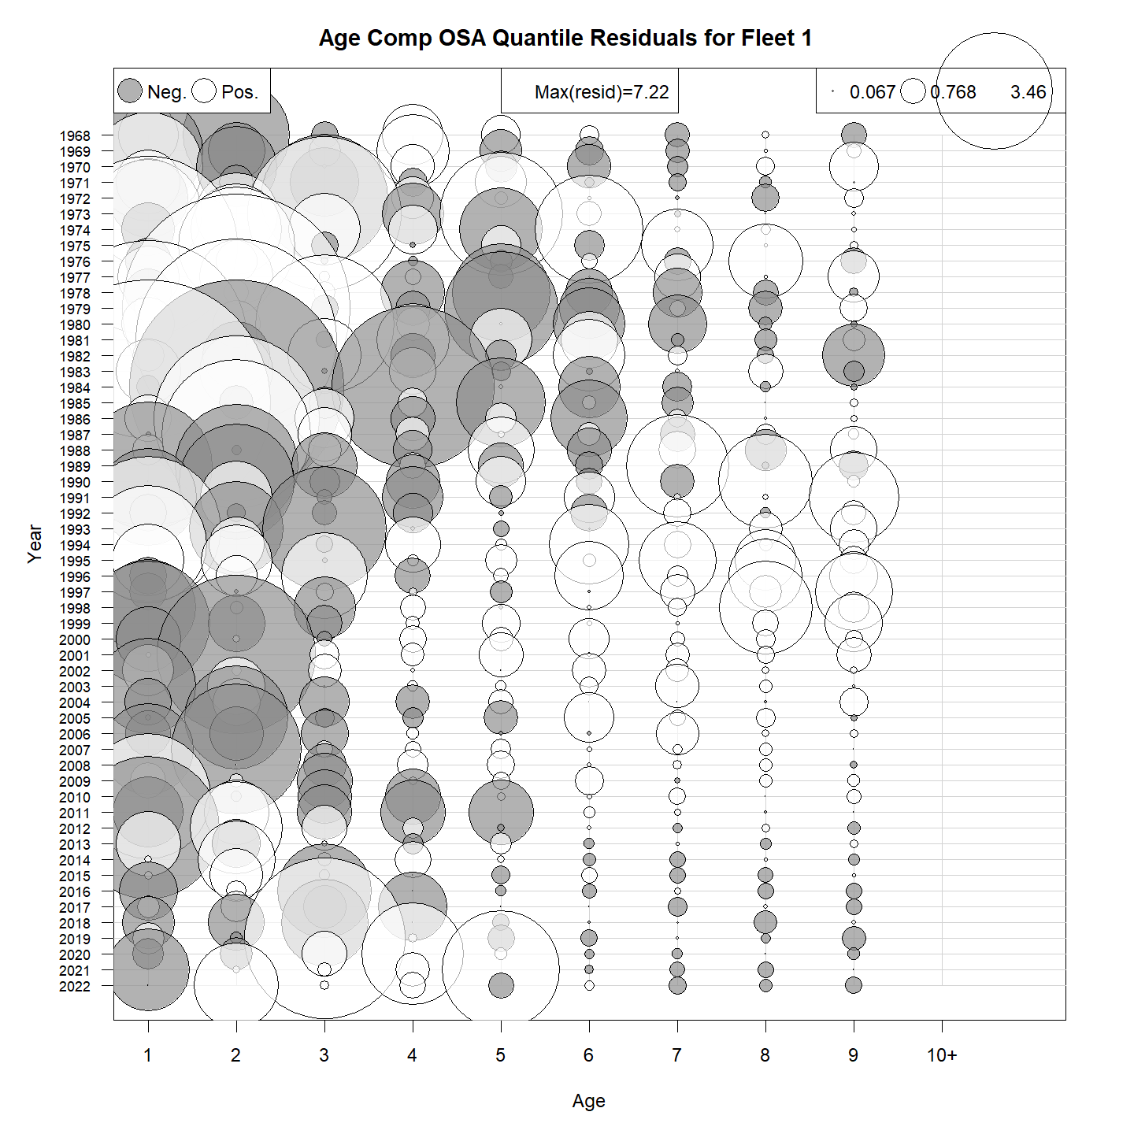
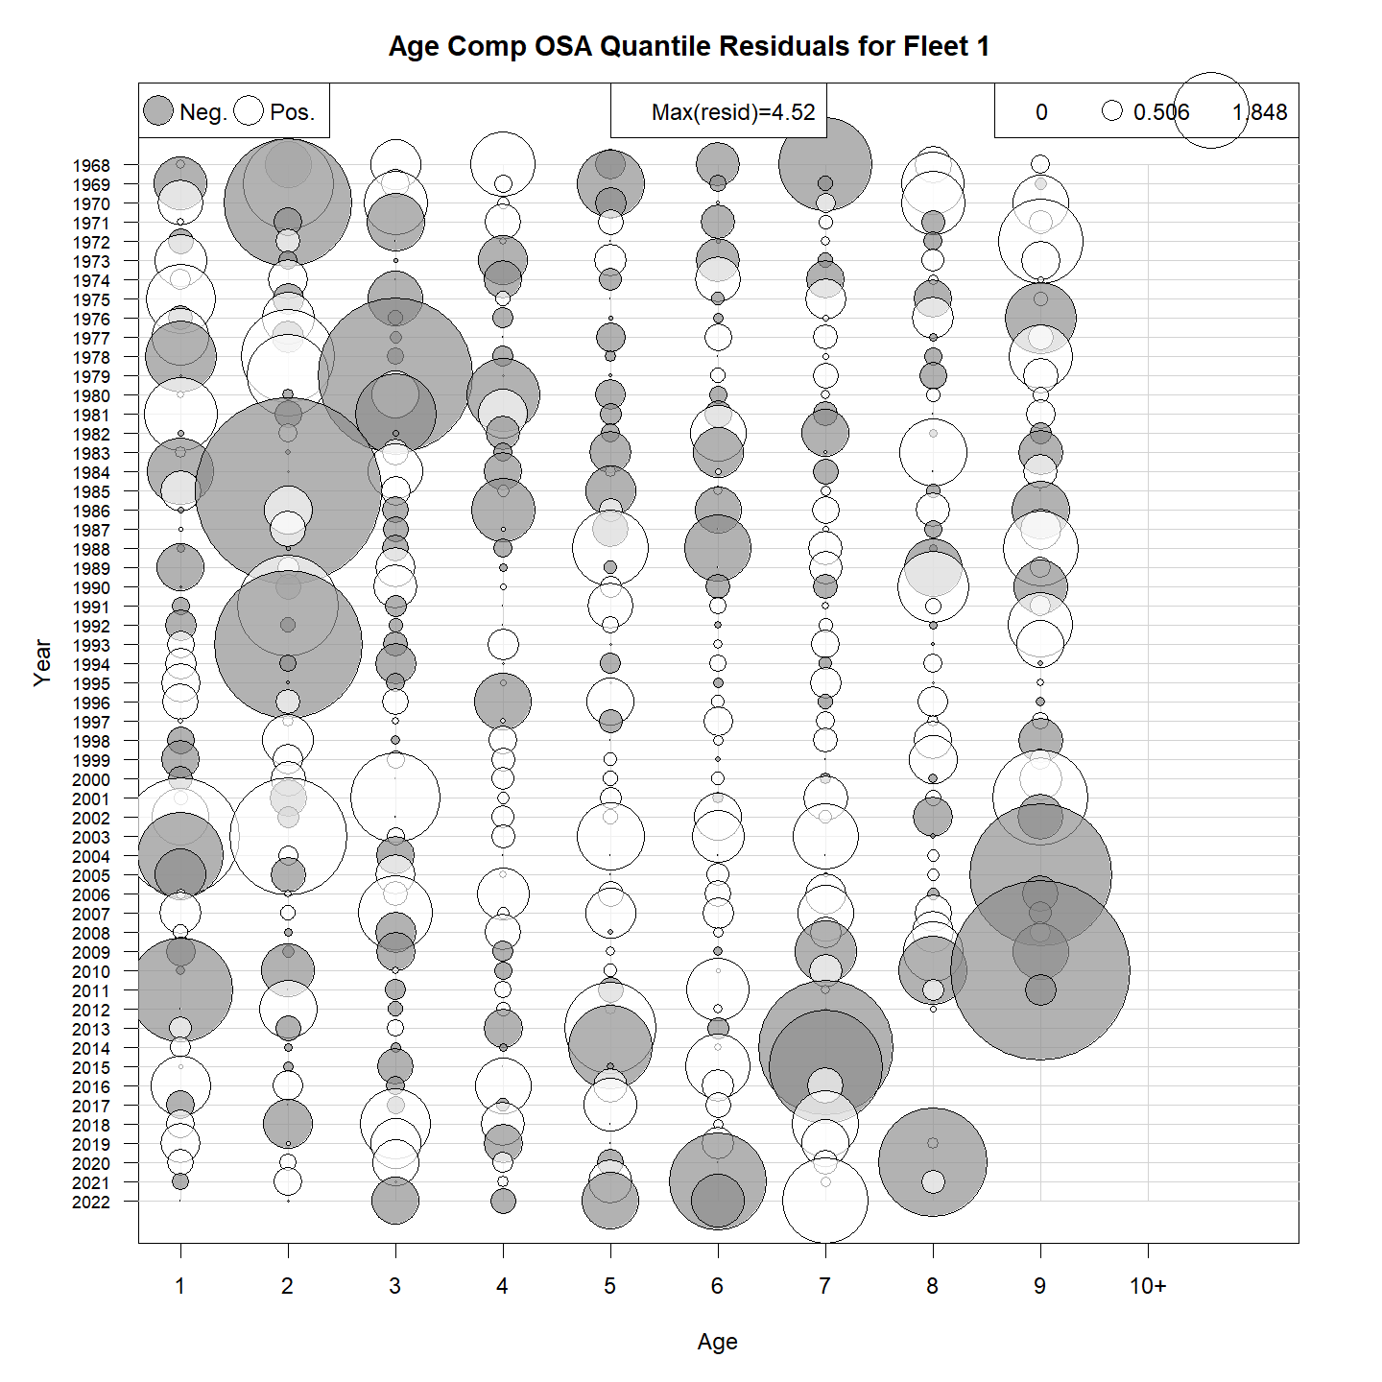
Fishery catch OSA residuals
GitHub Run1 & Run2
Multinomial
Logistic-normal-ar1-miss0

Slide 14
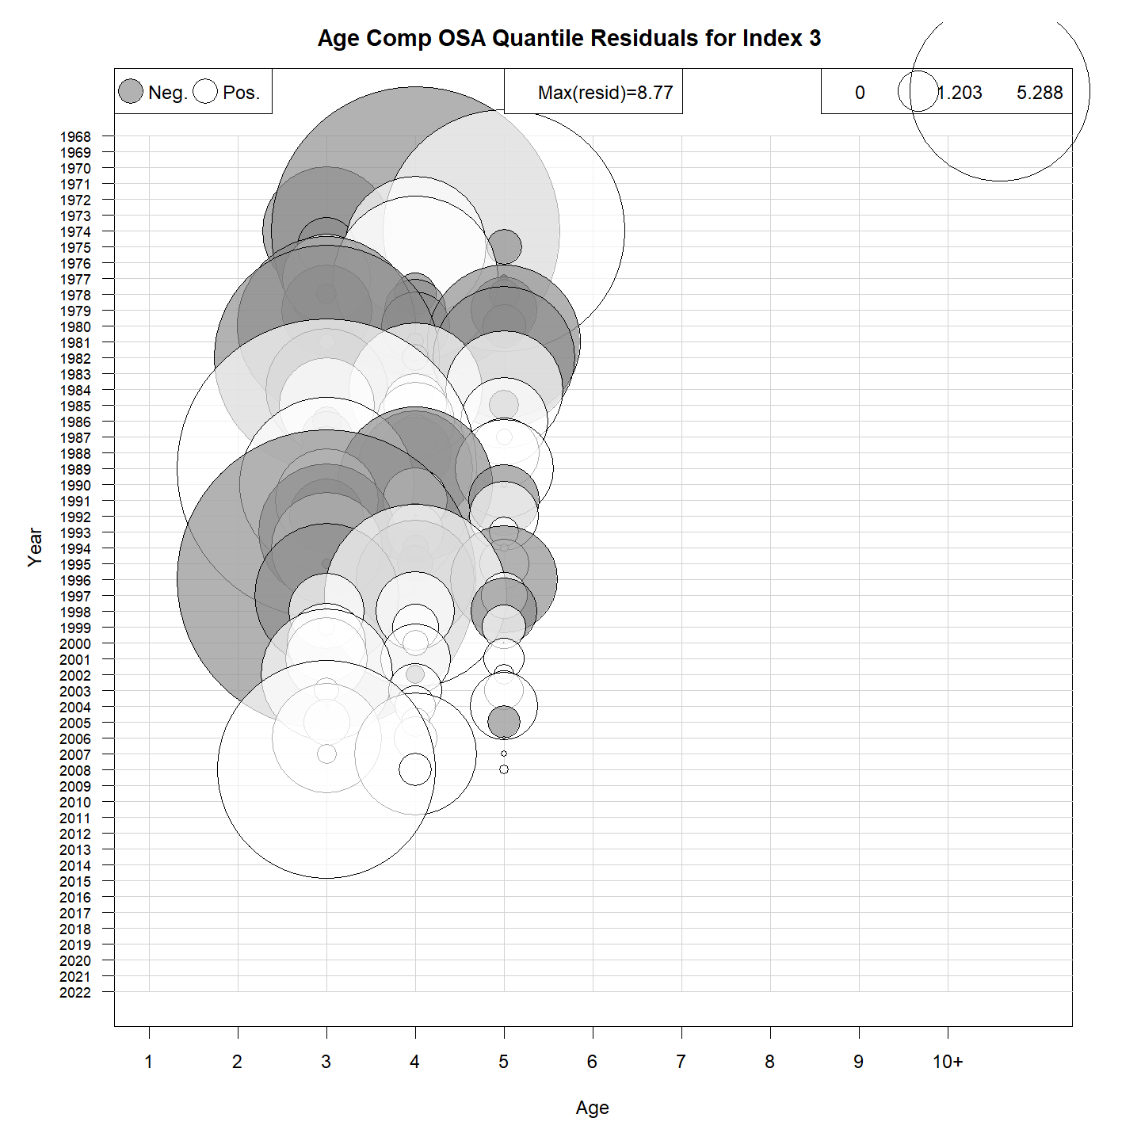
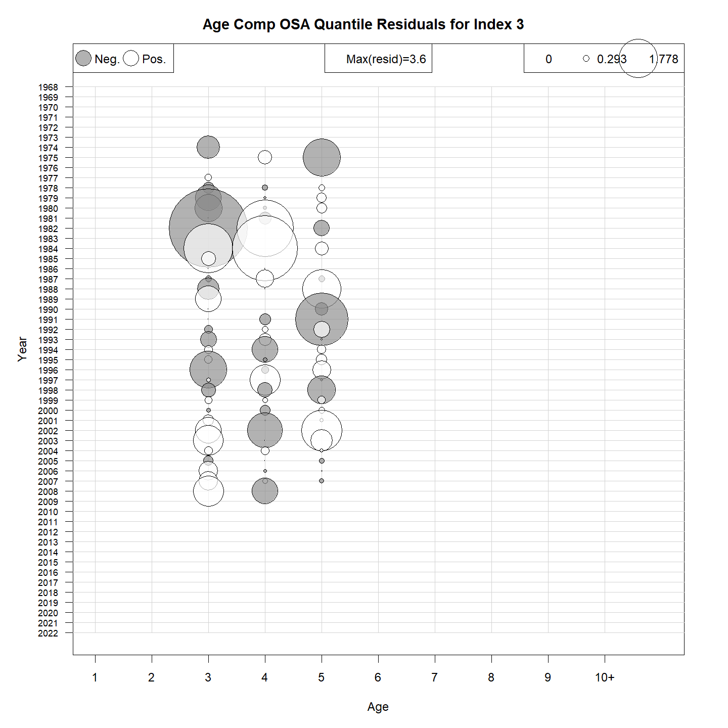
NEFSC Albatross OSA residuals
Multinomial
Logistic-normal-ar1-miss0

Slide 15
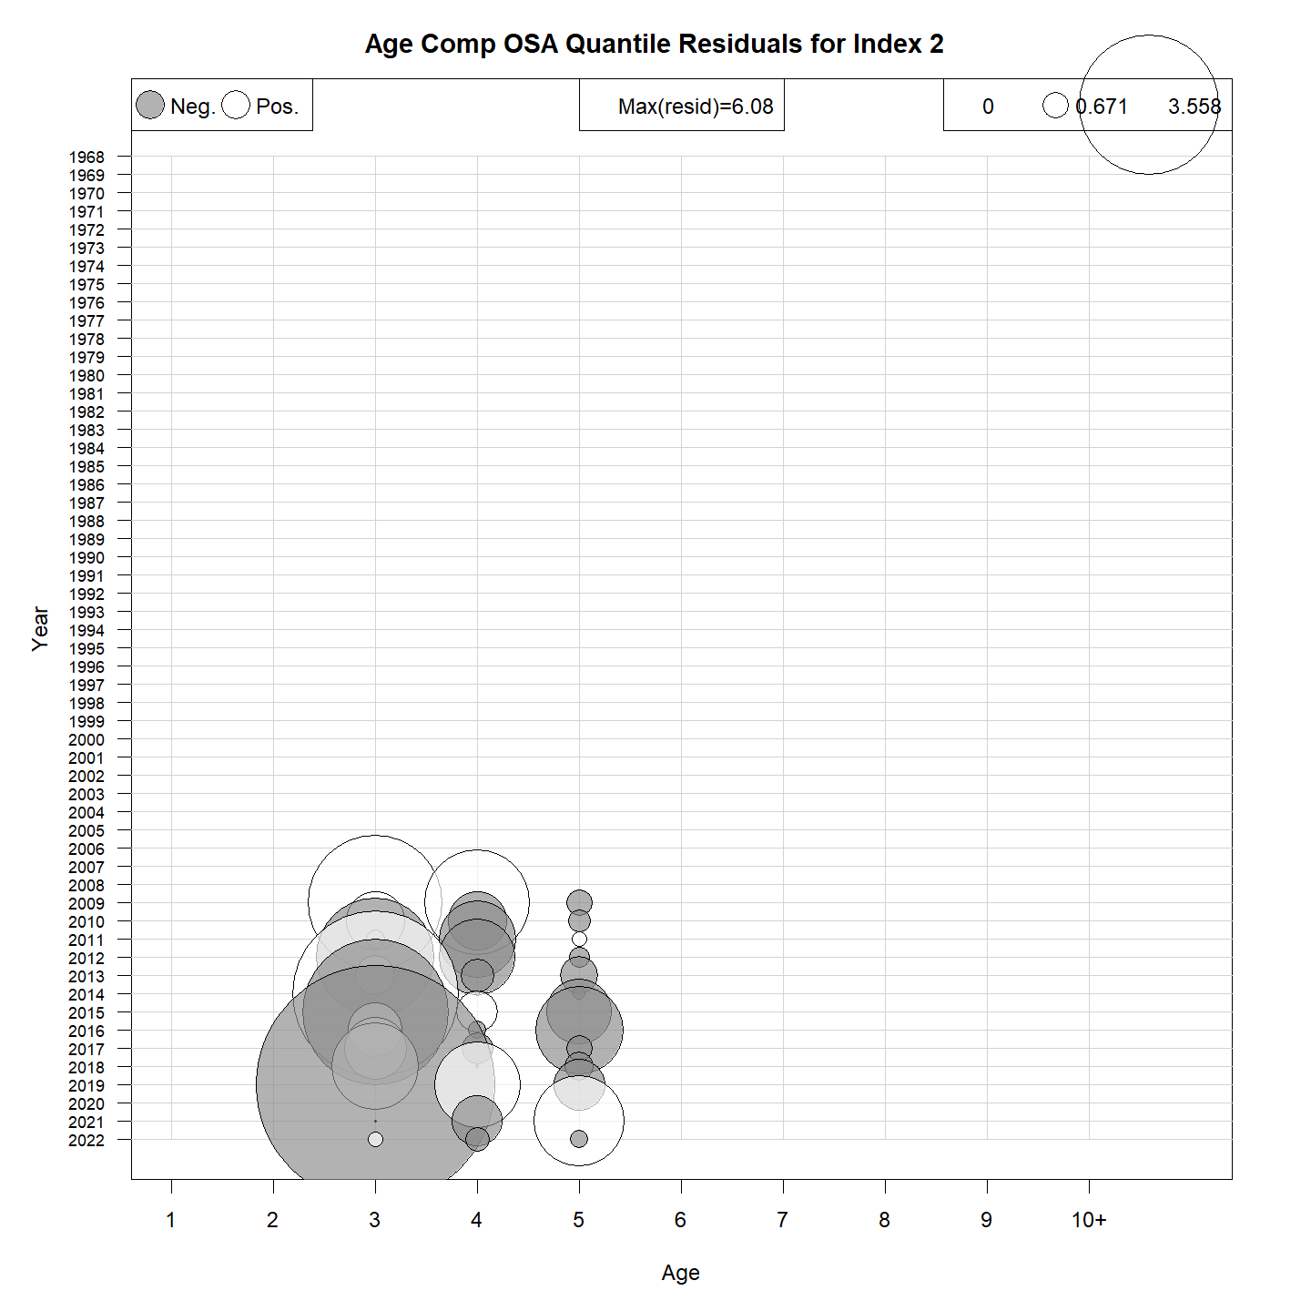
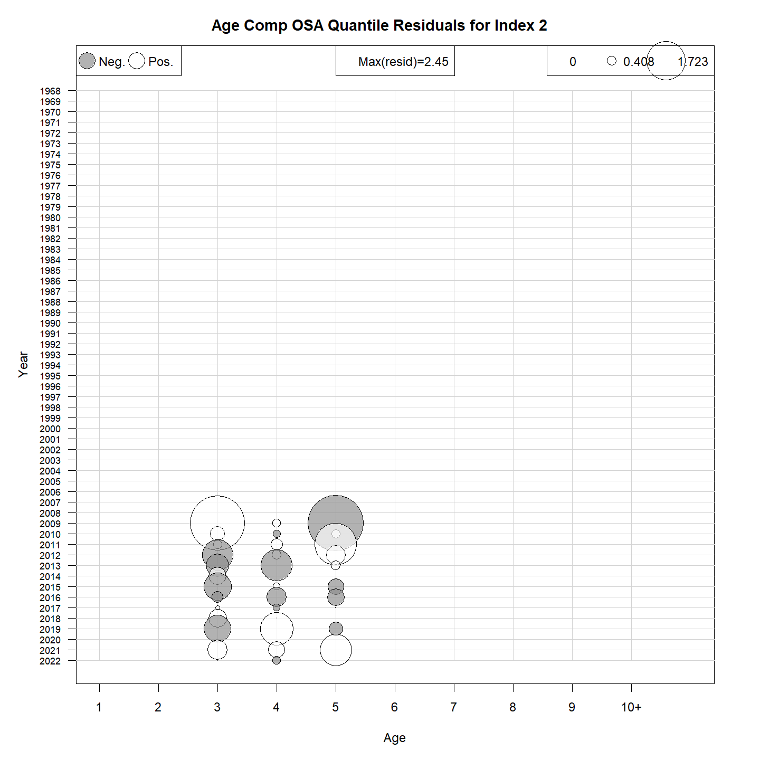
NEFSC Bigelow OSA residuals
Multinomial
Logistic-normal-ar1-miss0

Slide 16
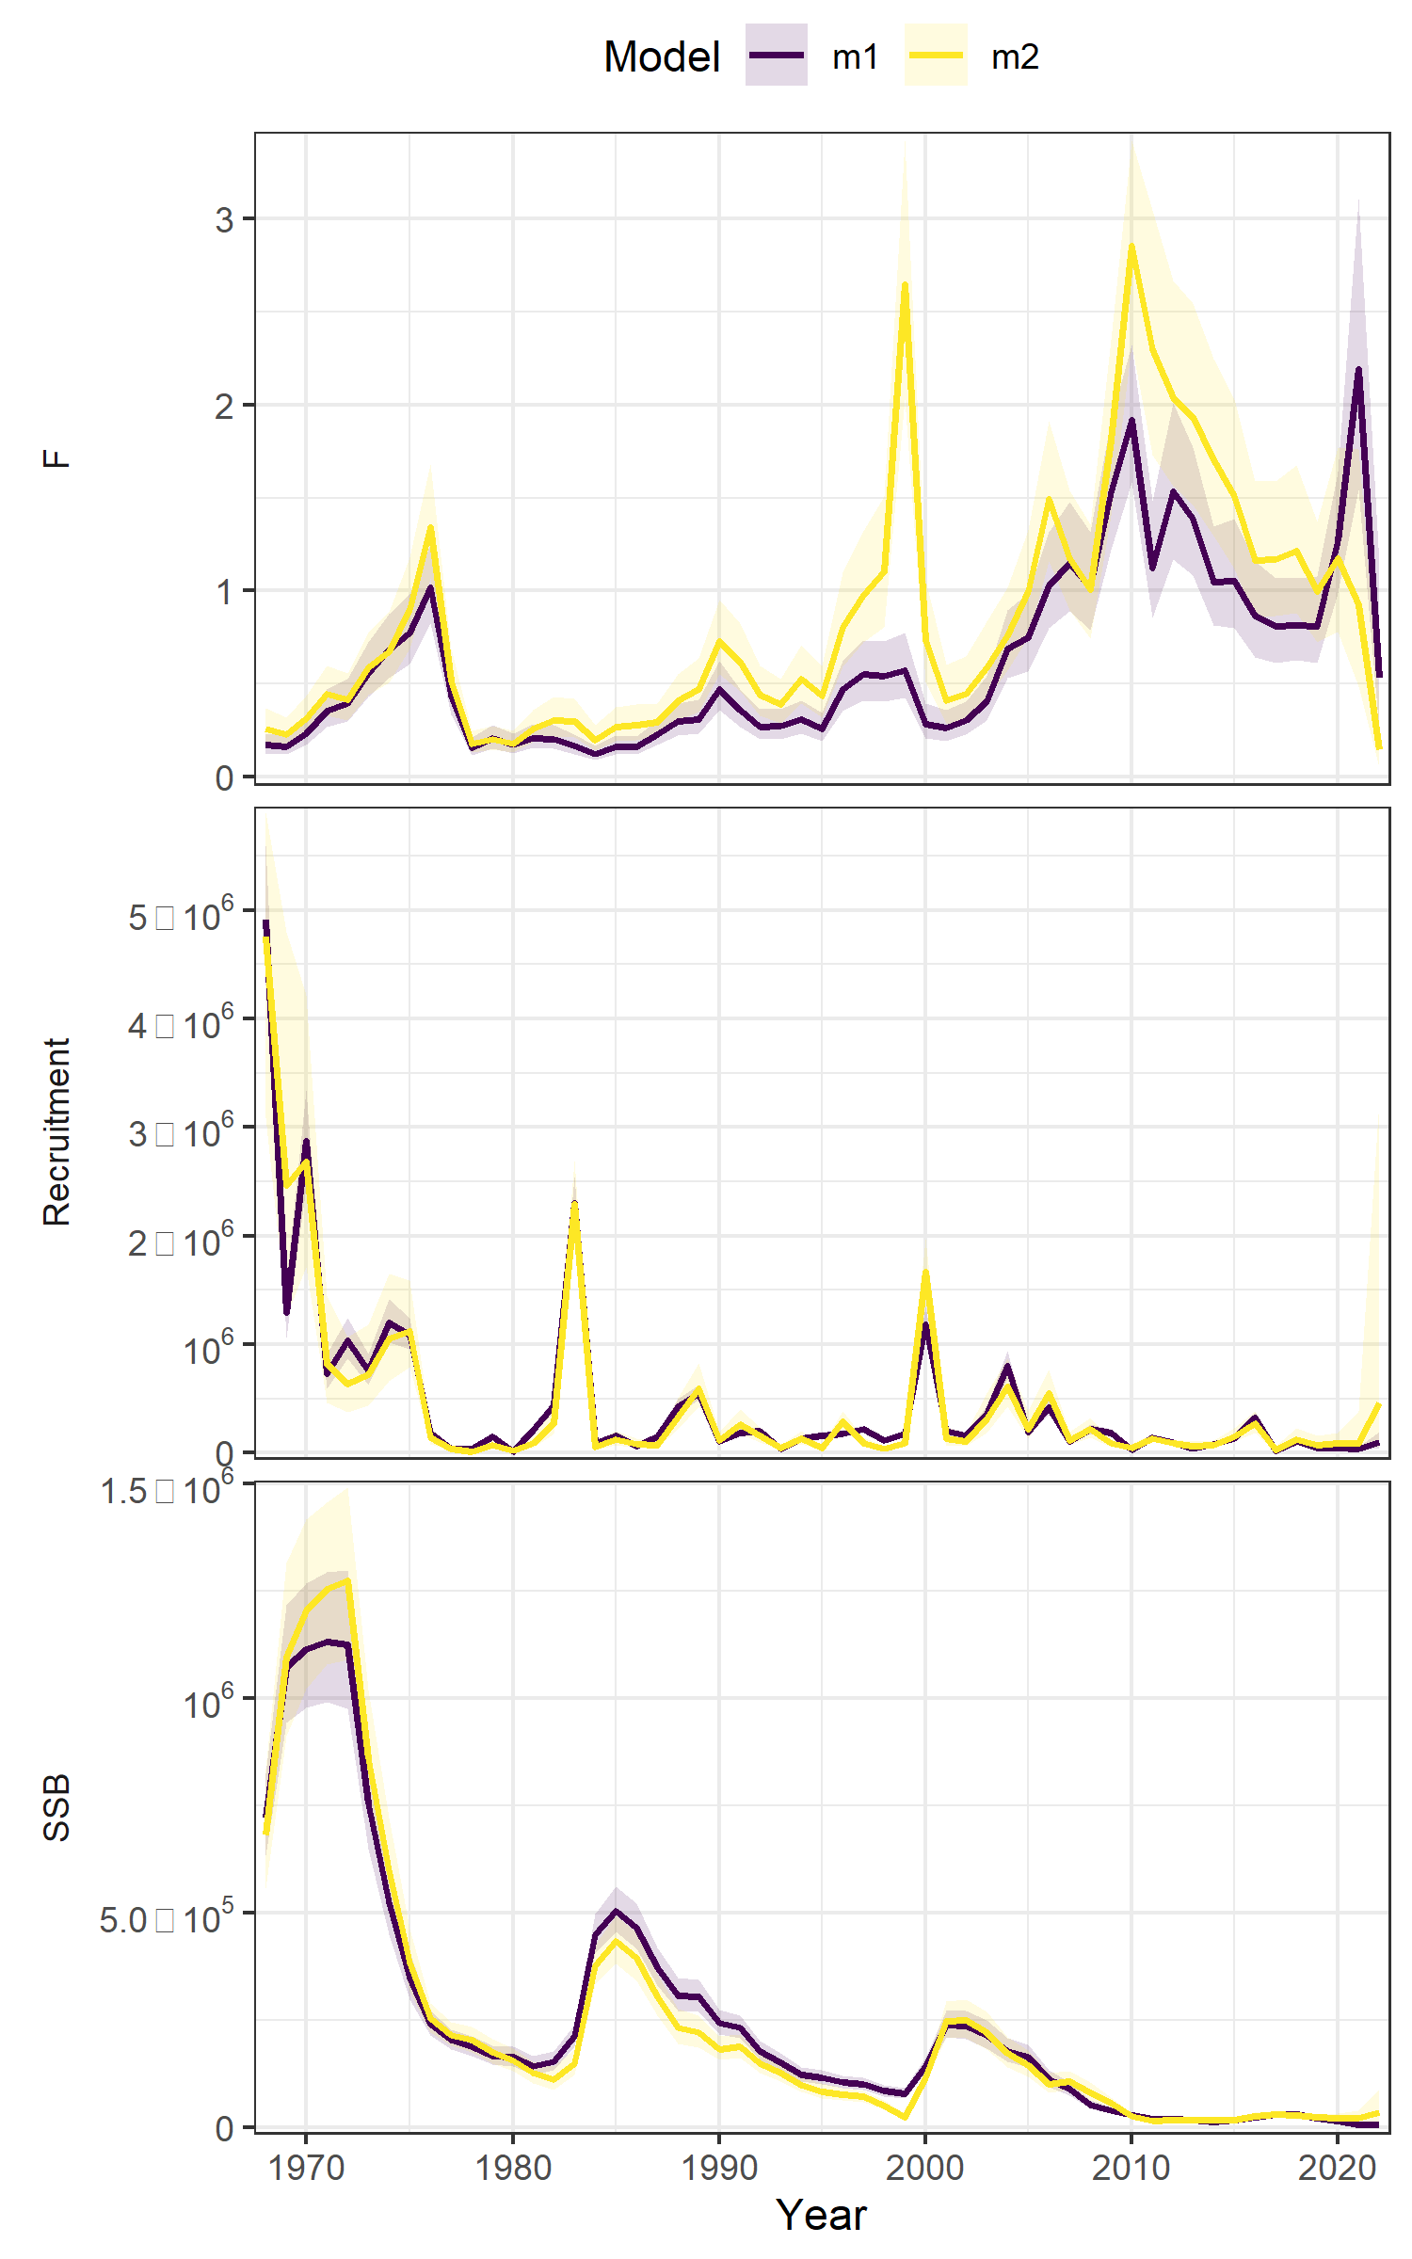
Age comp summary
Moved to logistic-normal
Run | age_comp | rho_R | rho_SSB | rho_Fbar
m1 | multinomial | 0.1608 | 0.3633 | -0.228
m2 | logistic-normal-ar1-miss0 | 0.8776 | 0.8802 | -0.4192
Figure 7 WP 10

Slide 17
The plan
ASAP → WHAM
Age-comps
Recruitment
Time varying
Selectivity
NAA

Slide 18
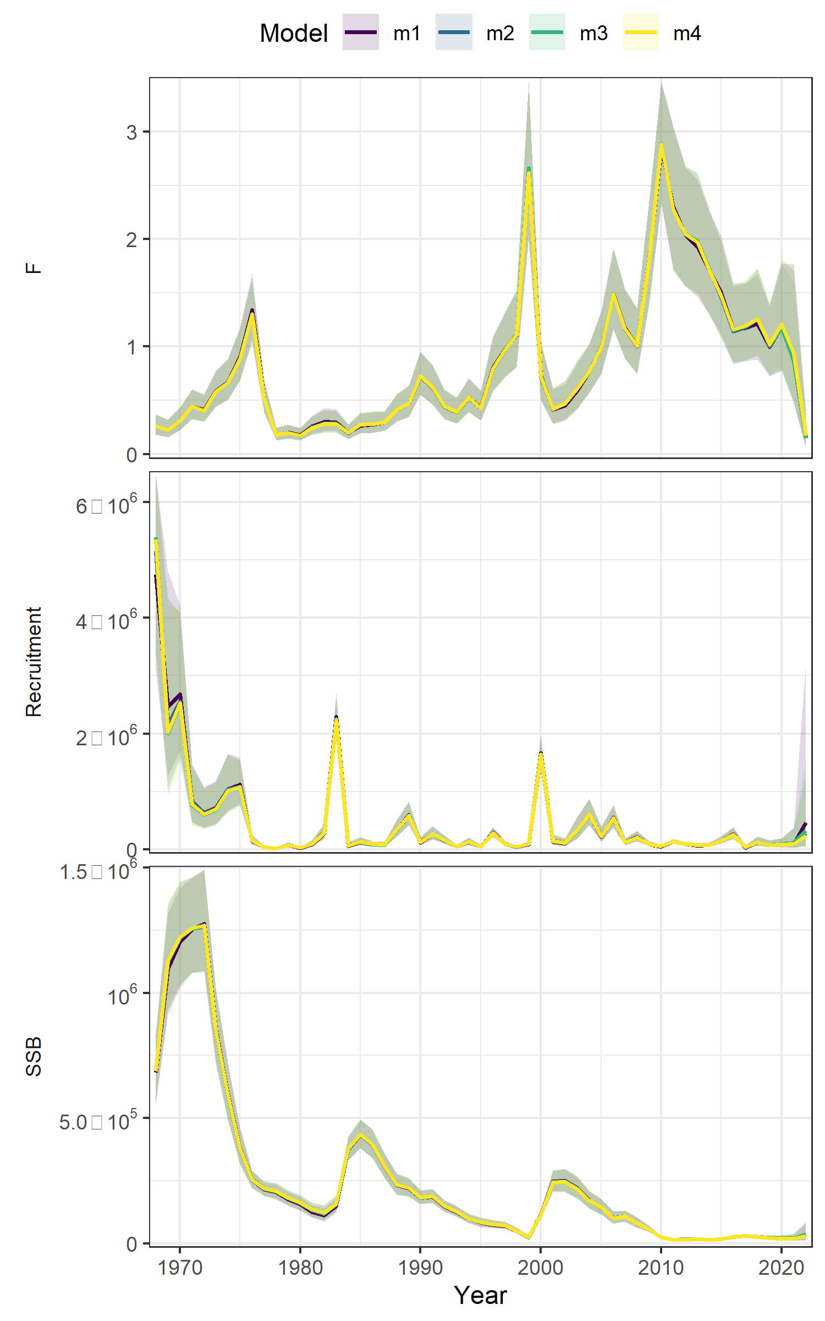
Recruitment
Runs | RE | dAIC | Rho R | Rho SSB | Rho Fbar | MASE egg | MASE Bigelow
m1 | None | 0 | 0.877 | 0.880 | -0.419 | 0.98 | 0.53
m2 | ar1 | 159.1 | 1.068 | 1.132 | -0.498 | 0.852 | 0.491
m3 | iid | 168.6 | 1.223 | 1.309 | -0.542 | 1.14 | 0.648
m4 | Beverton holt | 190.8 | 0.721 | 0.913 | -0.450 | 1.39 | 0.693
Table 2 WP 10
Figure 8 WP 10

Slide 19
The plan
ASAP → WHAM
Age-comps
Recruitment
Time varying
Selectivity
NAA

Slide 20
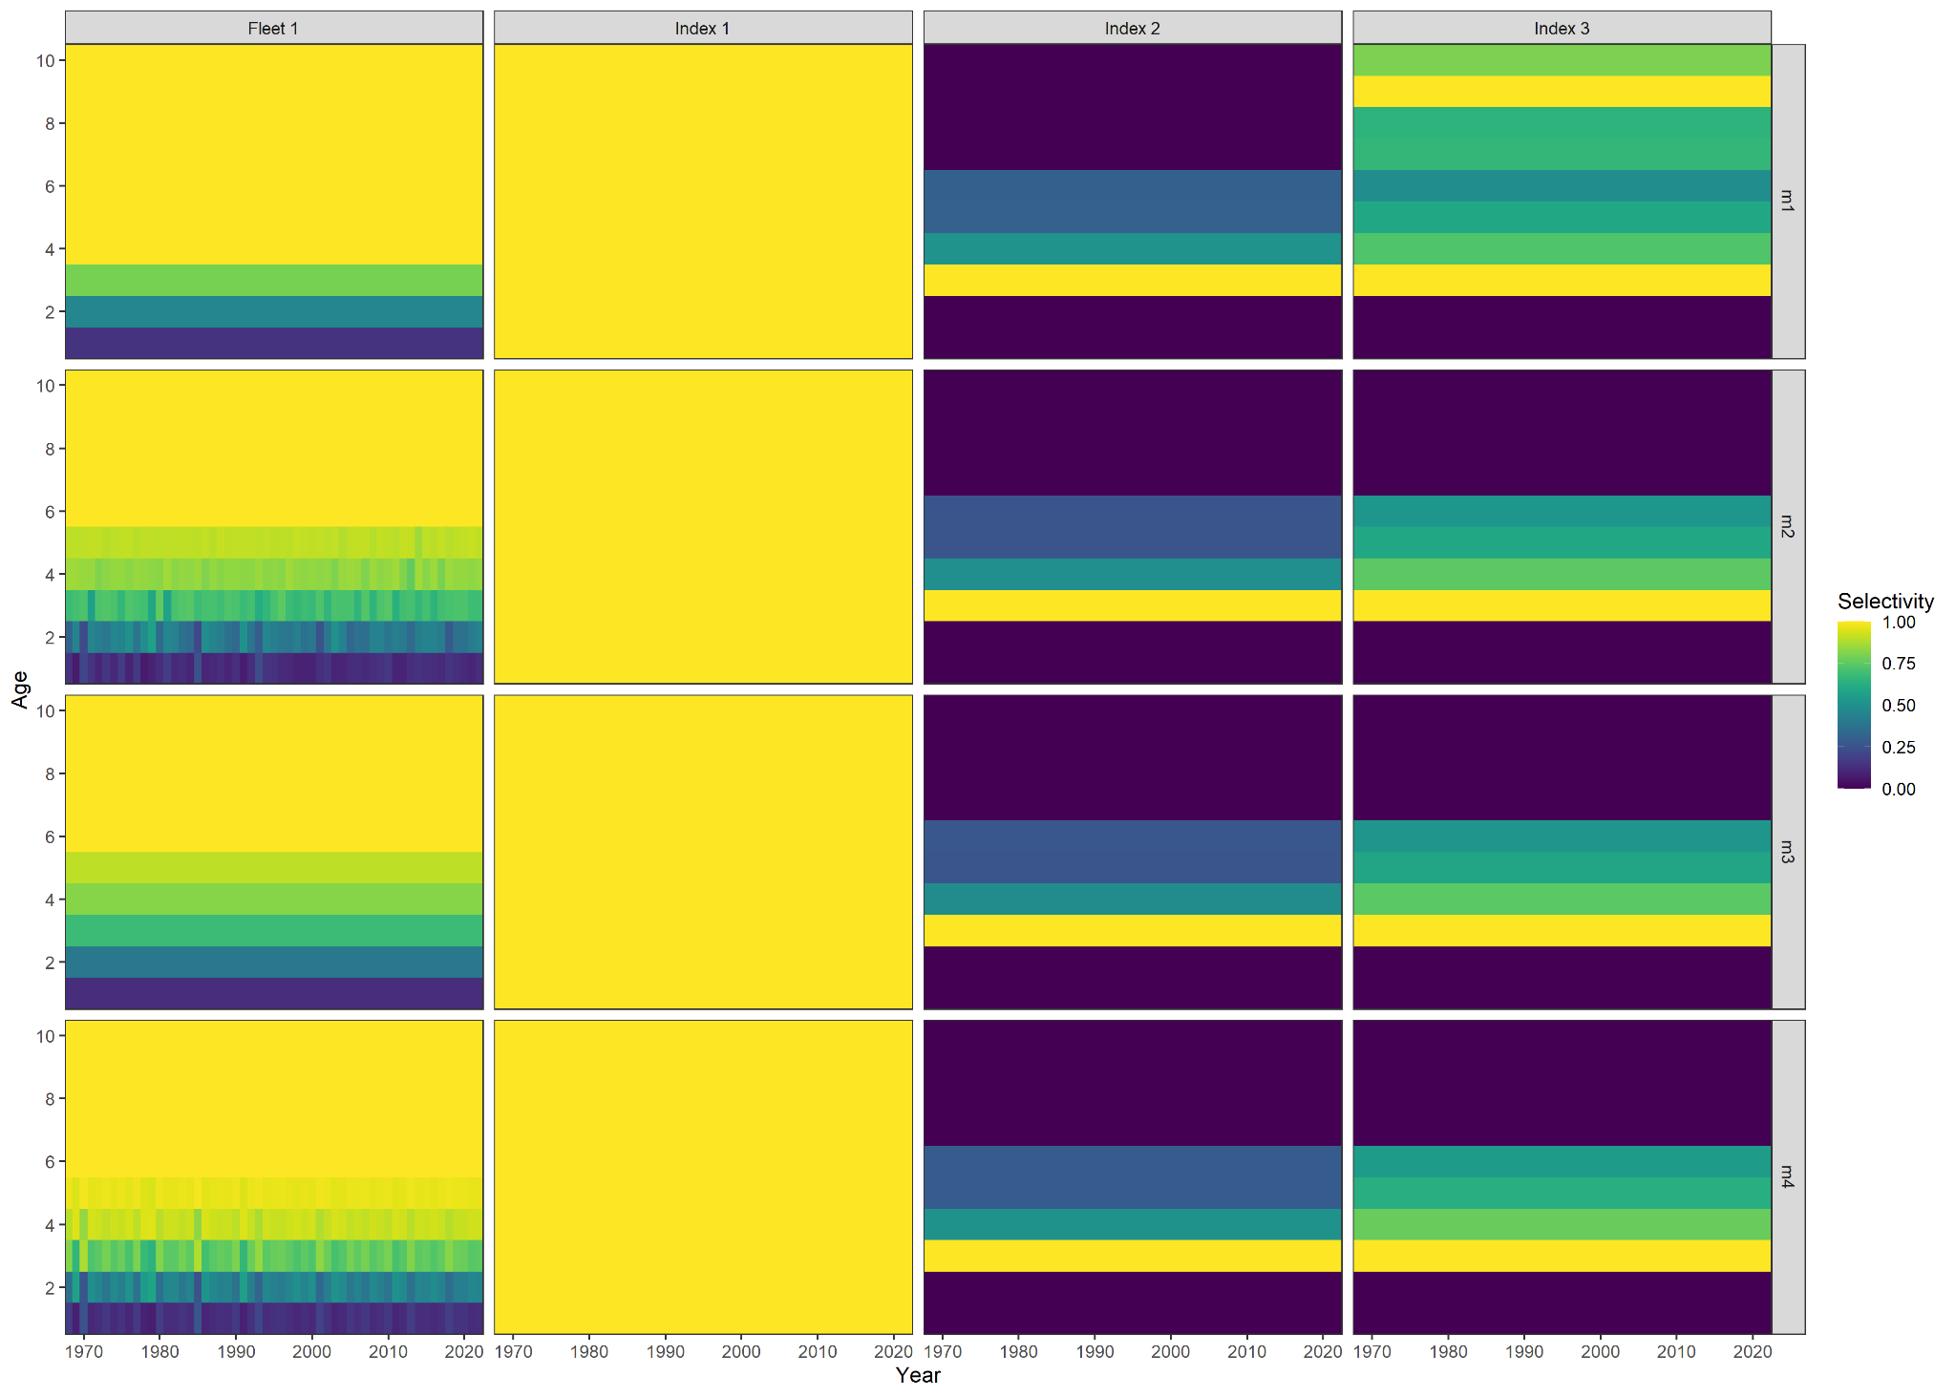
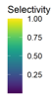
Time-varying selectivity
Runs | RE | dAIC | Rho R | Rho SSB | Rho Fbar | Mase egg | MASE Bigelow
m1 | None | 0 | 0.992 | 1.012 | -0.4596 | 0.98 | 0.53
m4 | 2dar-1 | 327.6 | 0.820 | 0.928 | -0.3835 | 1.02 | 0.583
m2 | iid | 330.4 | 0.609 | 0.703 | -0.3622 | 0.964 | 0.562
m3 | ar1_y | 342.2 | 0.877 | 0.880 | -0.4192 | 0.955 | 0.556
Table 3 WP 10
Figure 10 WP 10

Slide 21
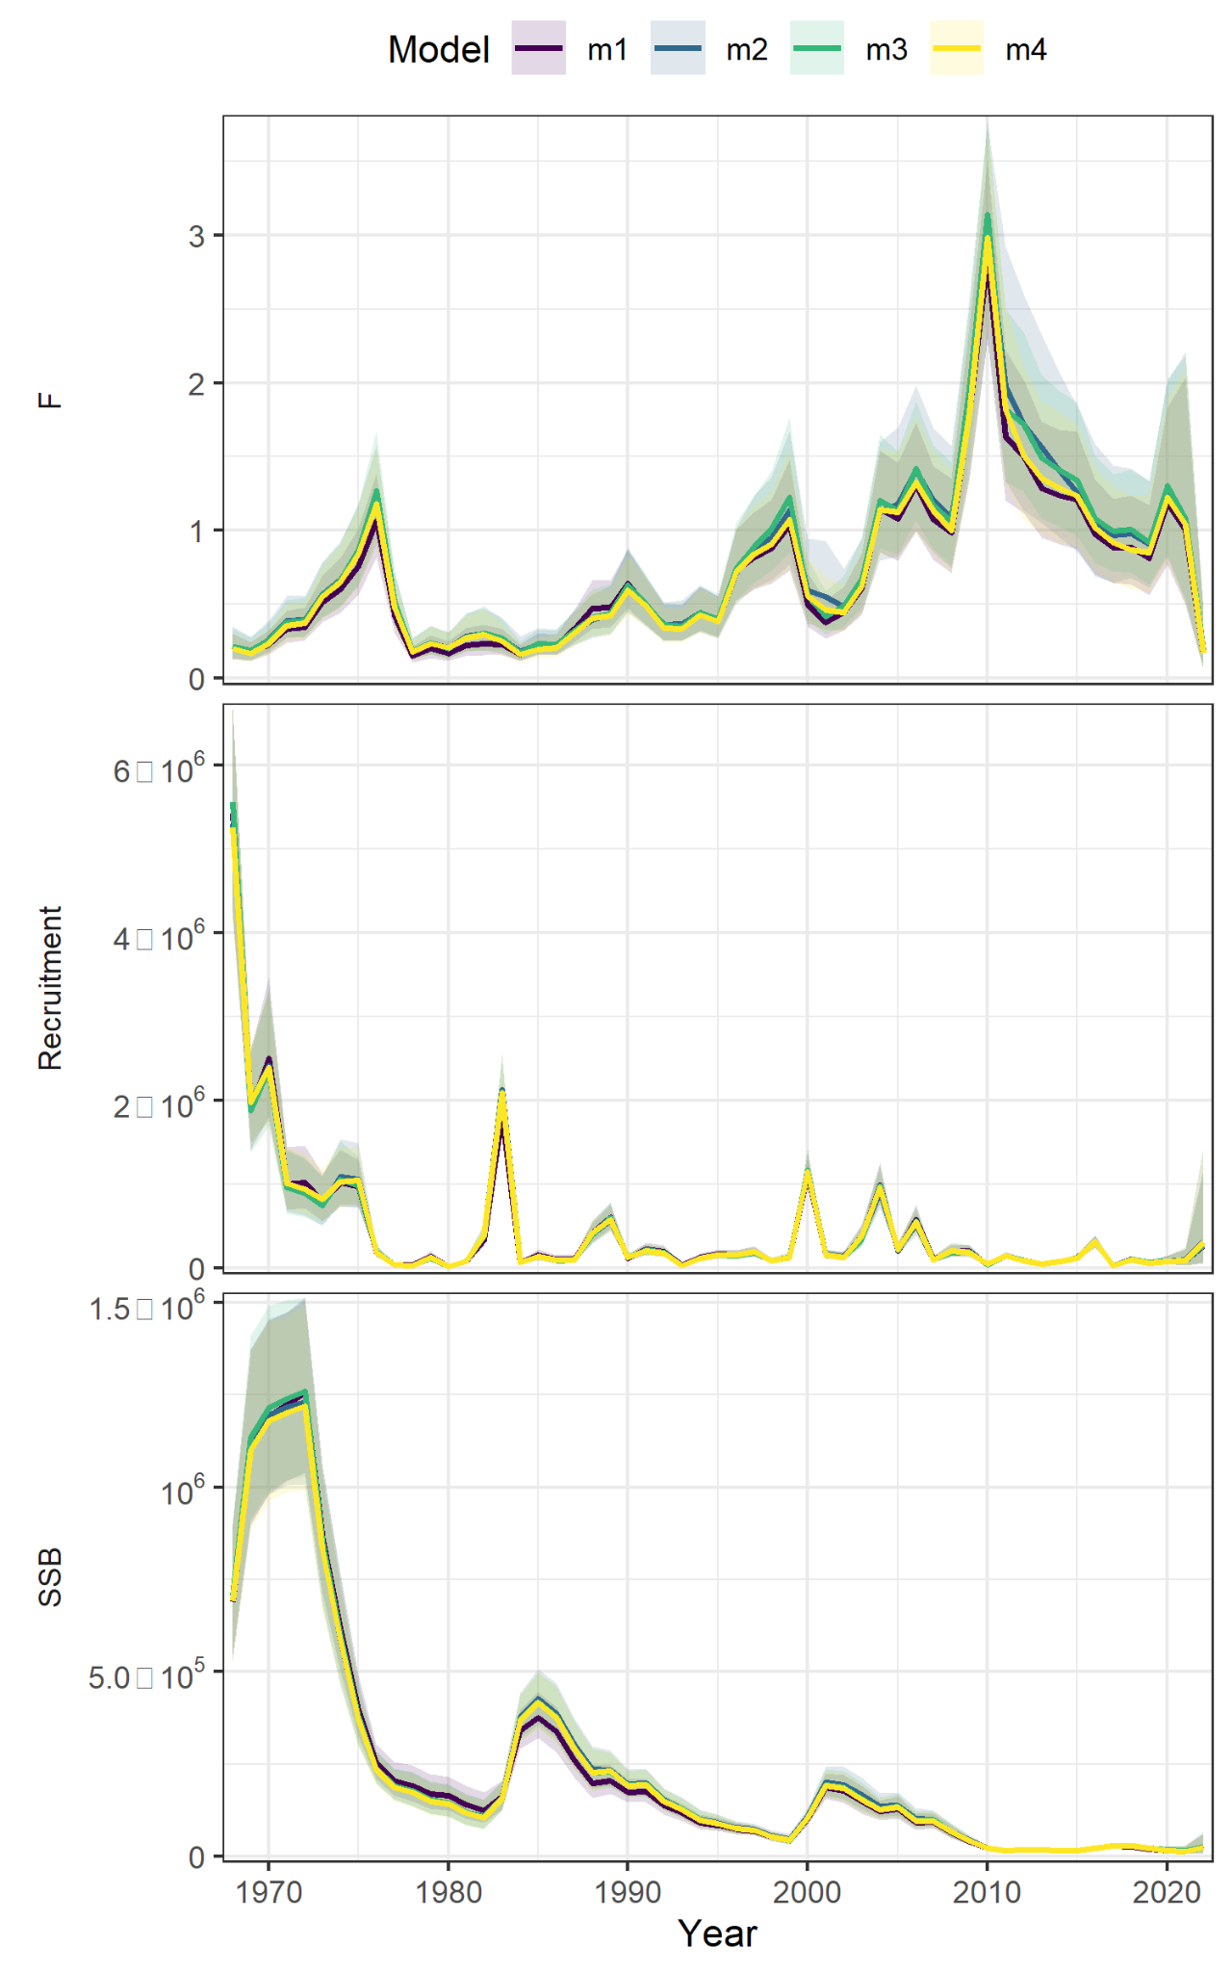
Time-varying selectivity
m1 = none
m2 = IID
m3 = AR1_y
m4 = 2DAR1
Figure 9 WP 10

Slide 22

The plan
ASAP → WHAM
Age-comps
Recruitment
Time varying
Selectivity
NAA

Slide 23
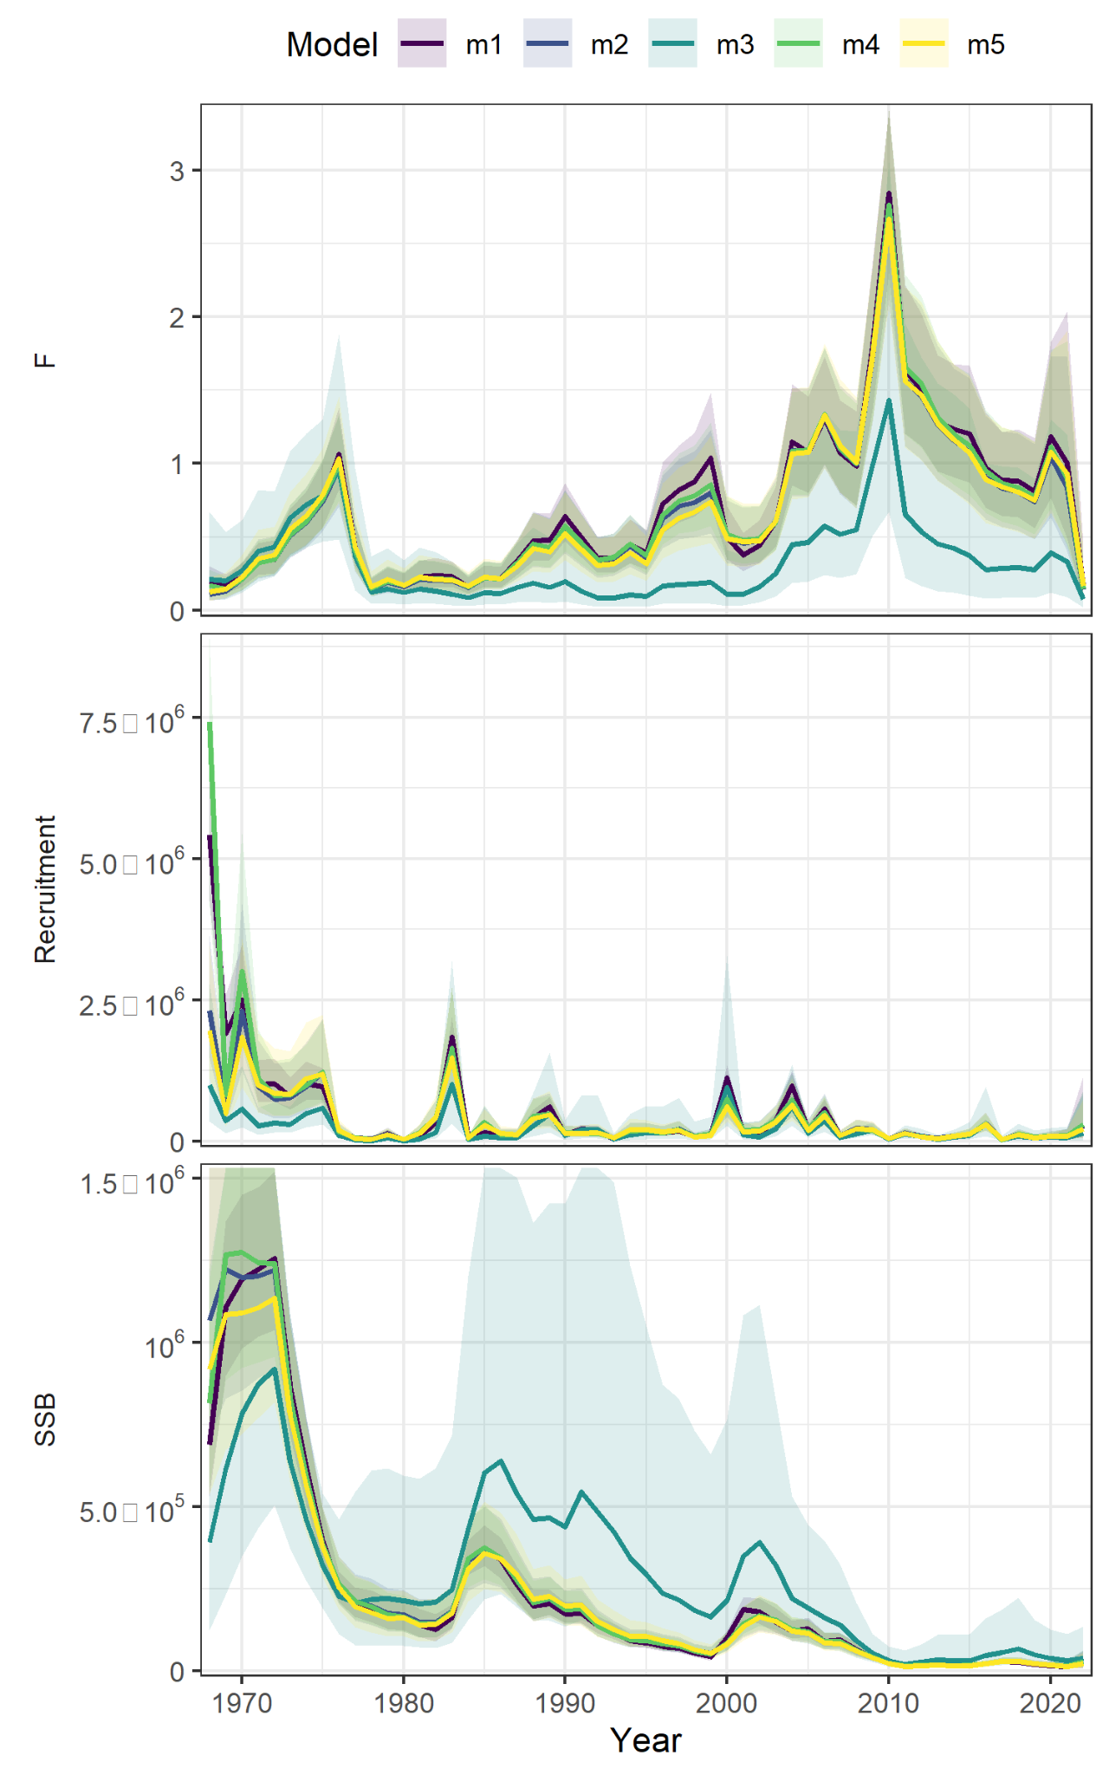
Random effects on NAA
Model | RE | dAIC | Rho R | Rho SSB | Rho Fbar | MASE egg | MASE Bigelow
m1 | none | 0 | 0.992 | 1.012 | -0.459 | 0.98 | 0.53
m4 | ar1_a | 152 | 1.090 | 1.231 | -0.535 | 0.91 | 0.47
m5 | ar1_y | 190.8 | 0.721 | 0.913 | -0.450 | 0.906 | 0.477
m2 | iid | 208.9 | 0.96 | 1.167 | -0.518 | 1.01 | 0.50
m3 | 2dar1 | 214.2 | 0.251 | 0.280 | -0.162 | 1.49 | 0.832
Table 3 WP 10
Figure 13 WP 10

Slide 24
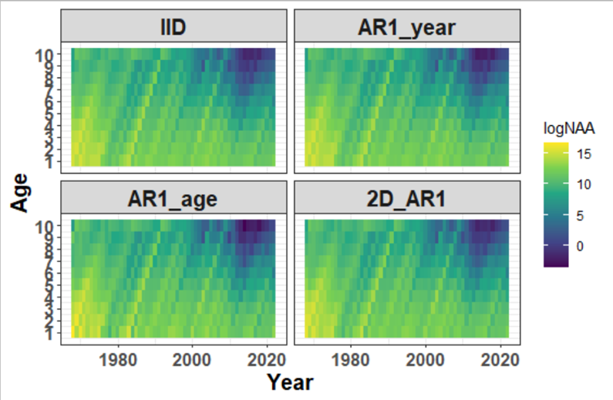
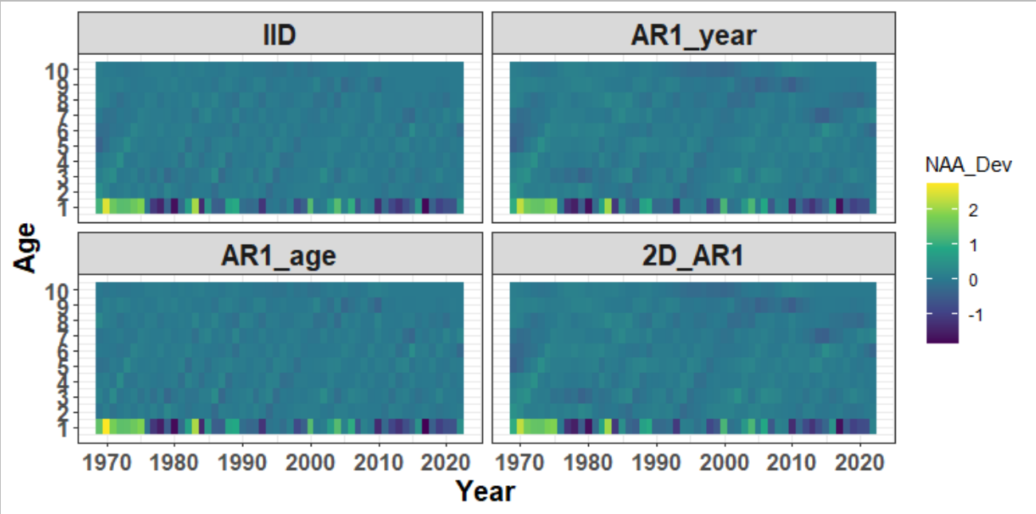
Random effects on NAA
Numbers at age
Deviations in numbers at age
Figure 11 WP 10
Figure 12 WP 10

Slide 25
Parameterization summary
Ages 1-10+
Fishery catch (1968-2022)
Surveys:
NEFSC spring (Albatross 1974-2008 ; ages 3+)
NEFSC spring (Bigelow 2009-2022; ages 3+)
Egg survey (1983-2022)
Natural mortality = 0.2
ASAP
Multinomial
Fixed effects only
WHAM
Logistic-normal-ar1-miss0
2dar1 on NAA

Slide 26
Selectivity
Block 1 = Fishery catch
Block 2 = Egg index
Block 3 = Bigelow
Block 4= Albatross

Slide 27
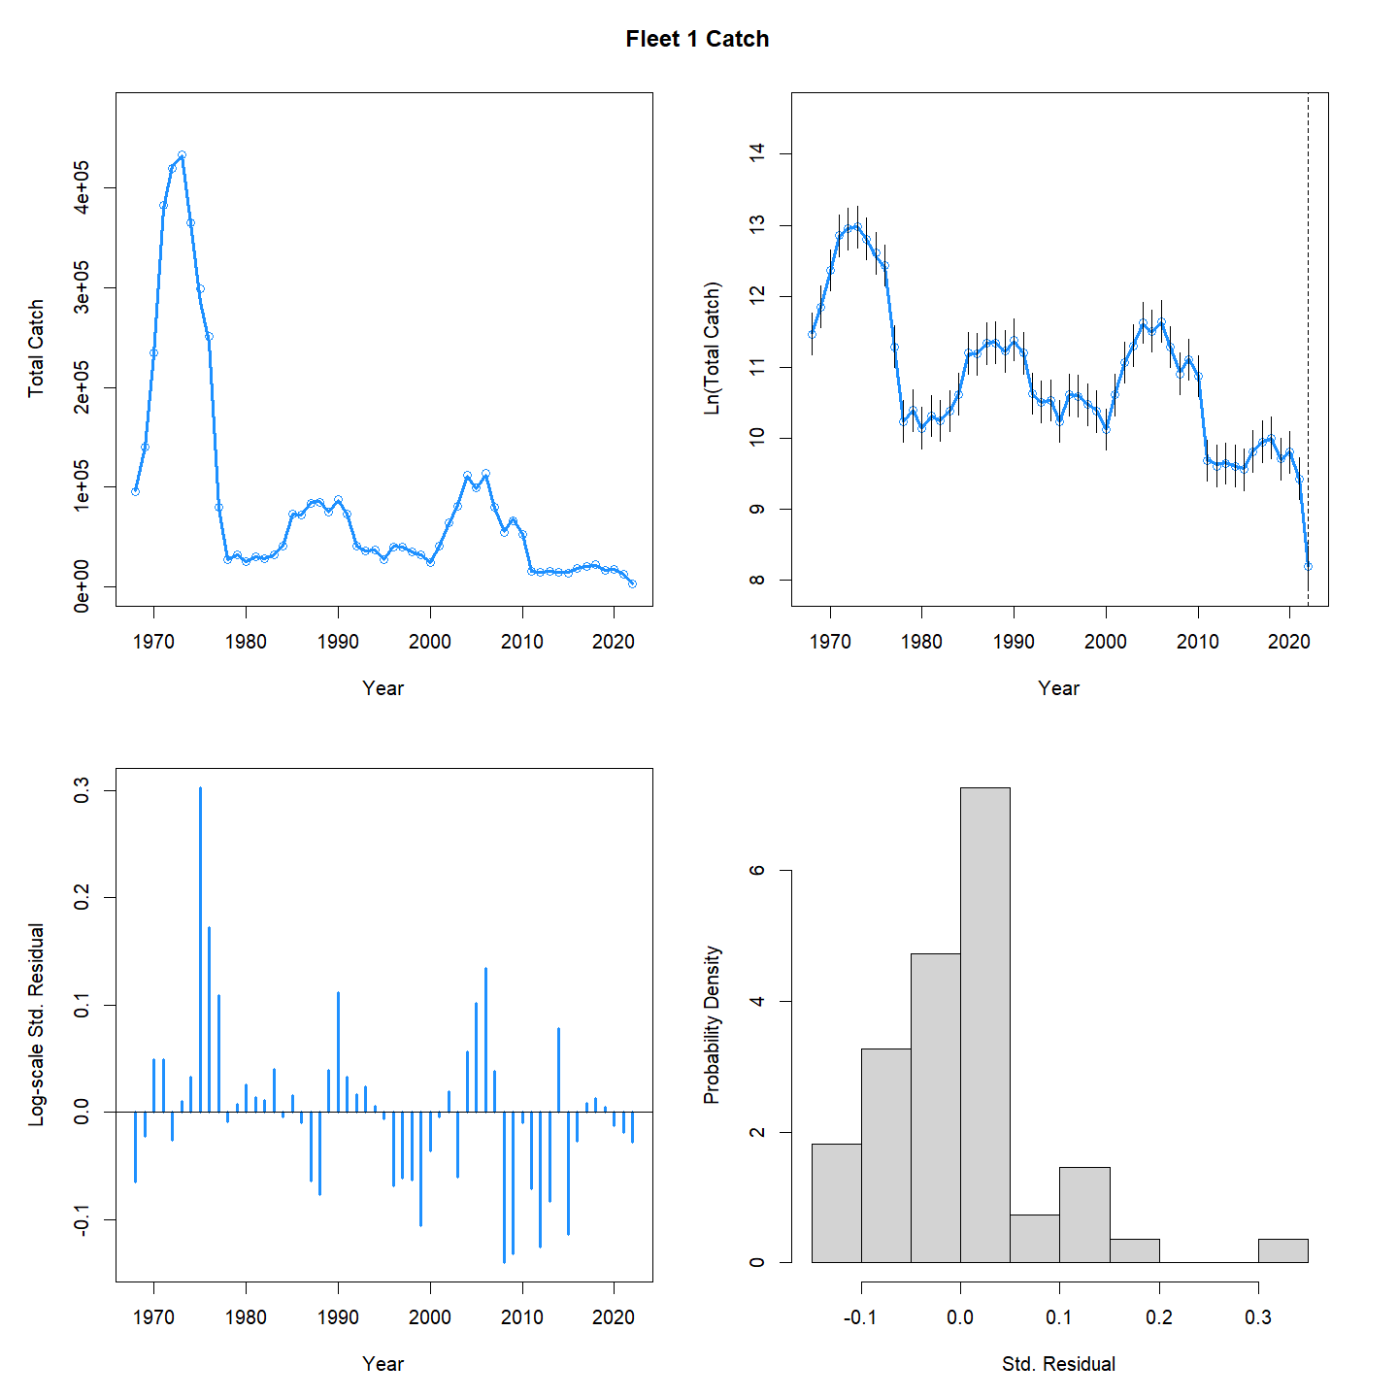
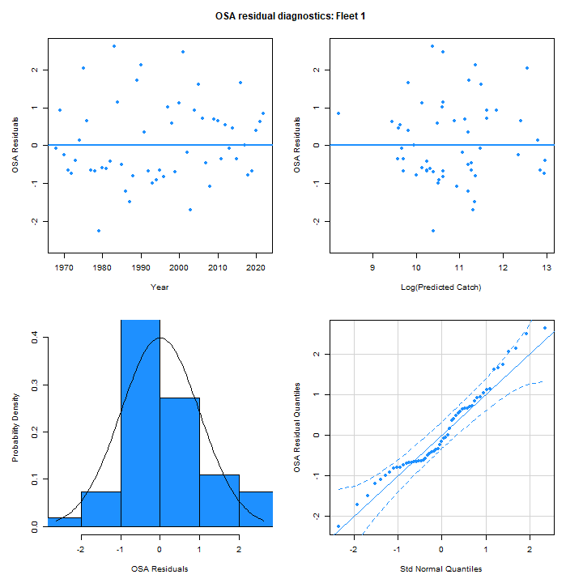
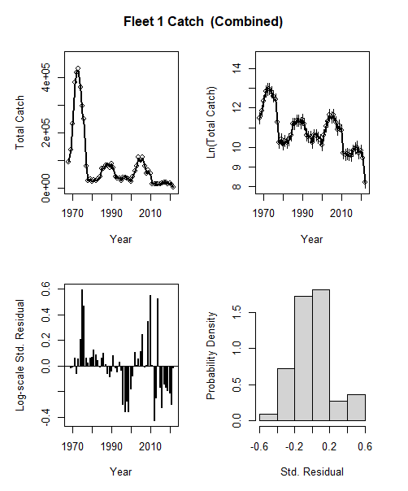
Catch aggregate fit
WHAM
ASAP
Figure 14 WP 10

Slide 28
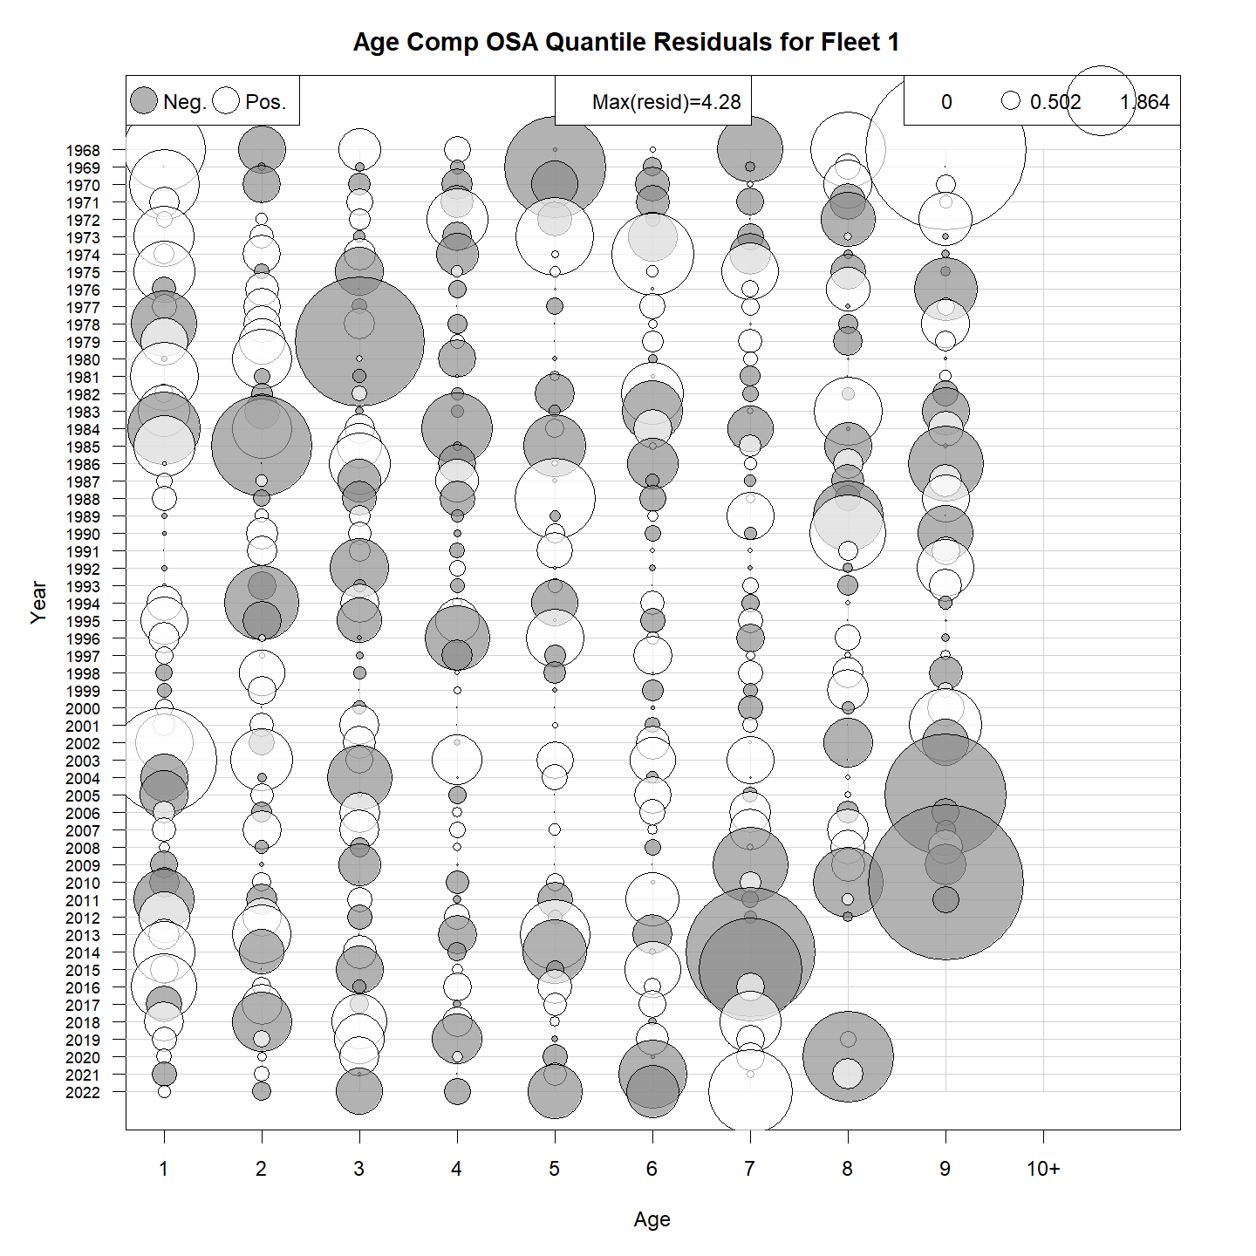
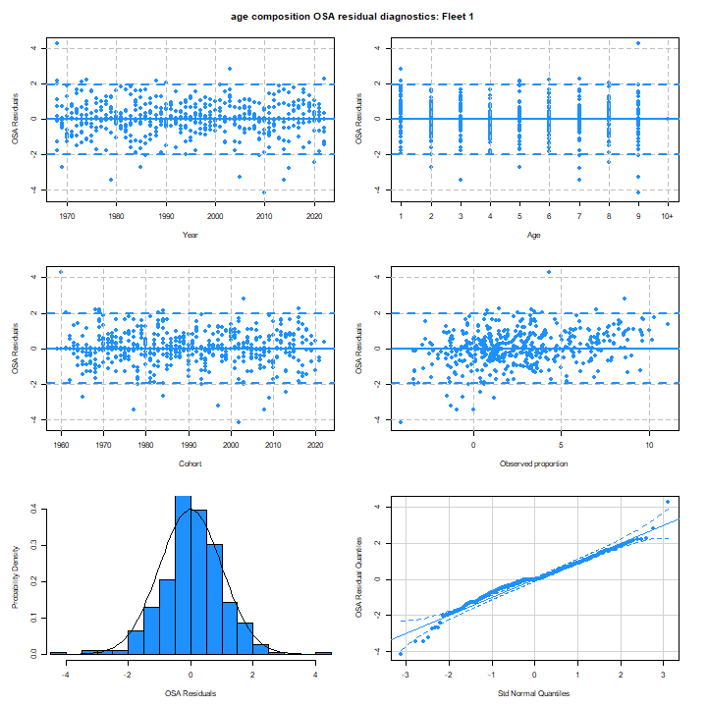
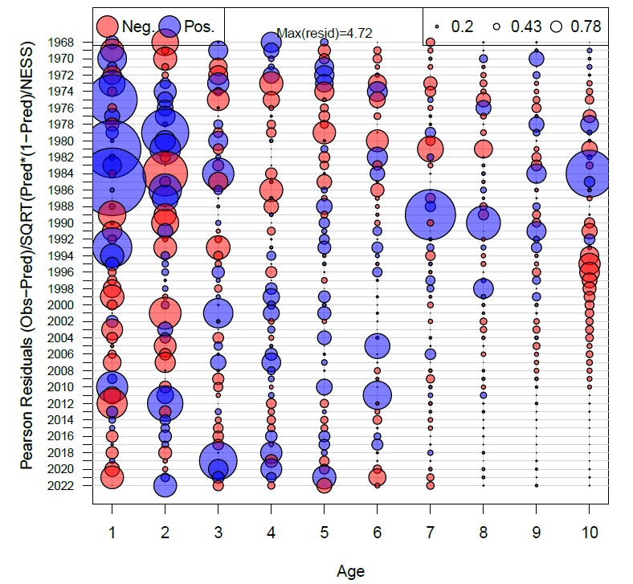
Catch age compositions
WHAM (OSA)
ASAP (Pearson)
Figure 18 WP 10

Slide 29
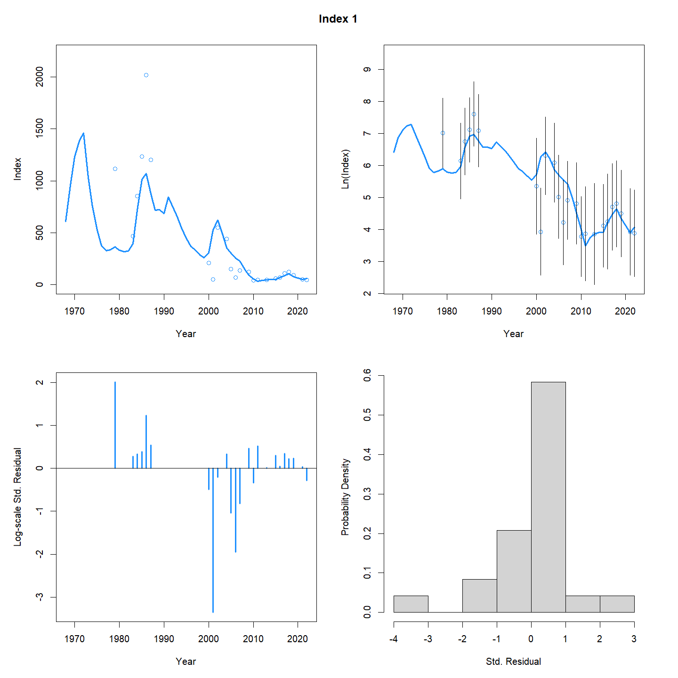
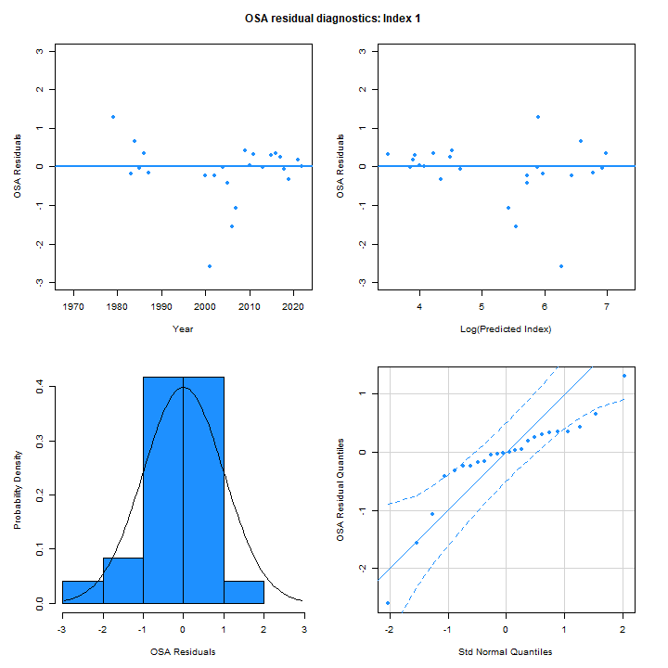
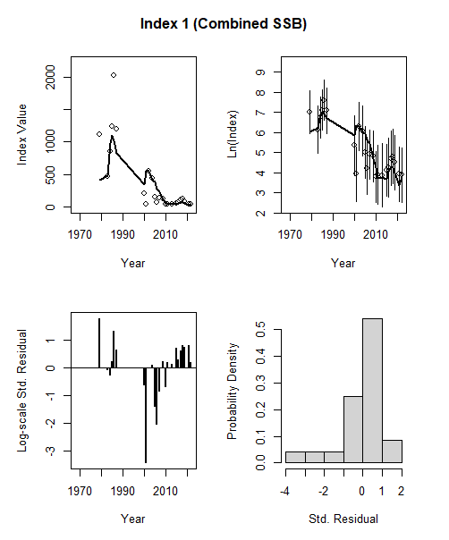
Egg survey aggregate fit
WHAM
ASAP
Figure 15 WP 10

Slide 30
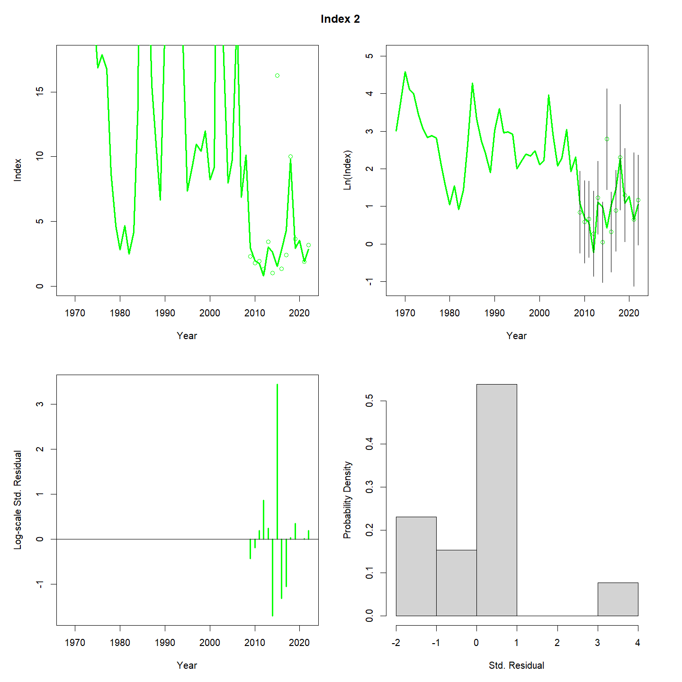
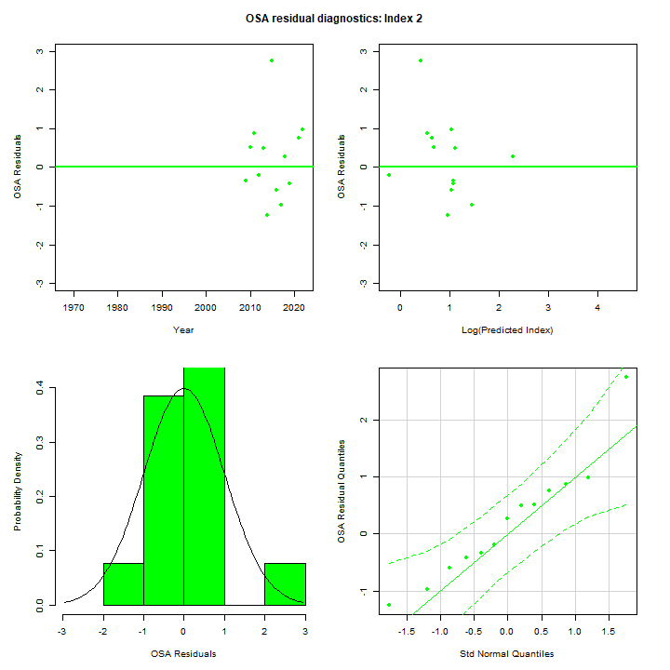
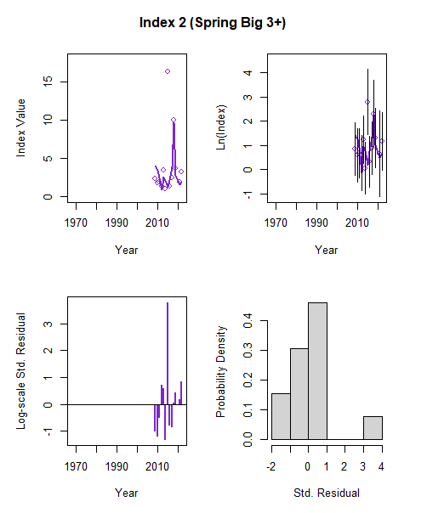
Bigelow survey aggregate fit
WHAM
ASAP
Figure 16 WP 10

Slide 31
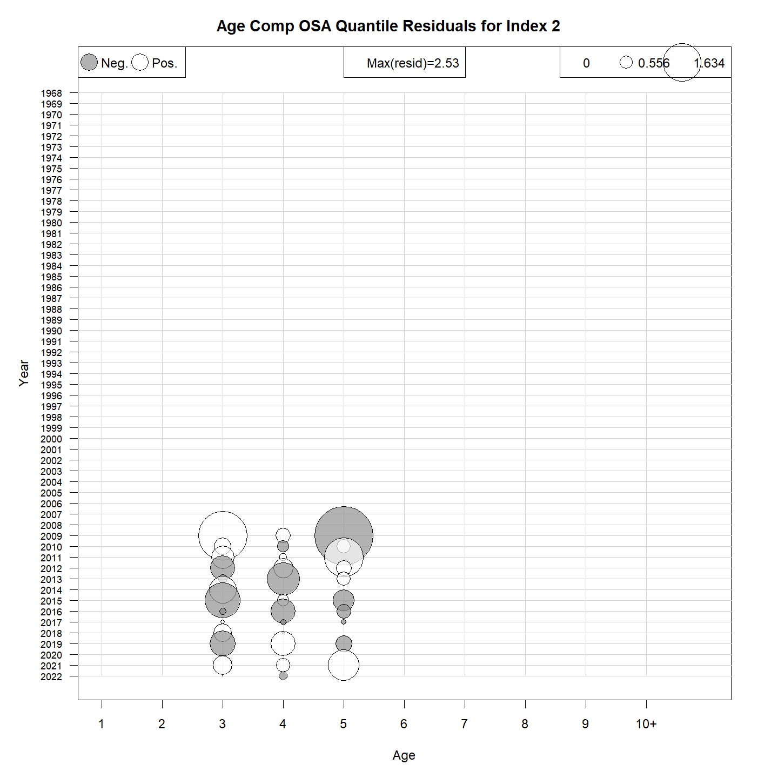
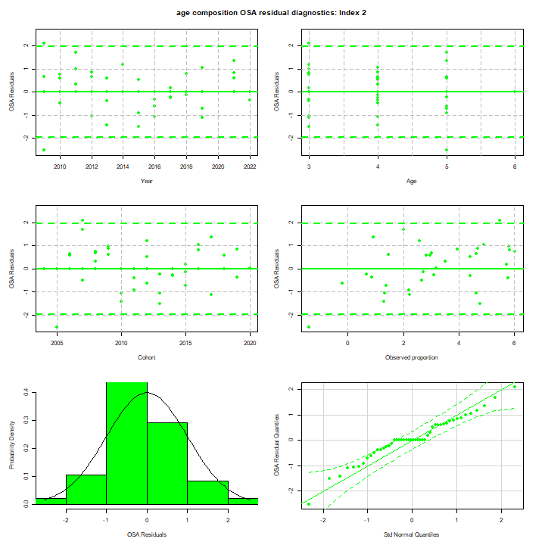
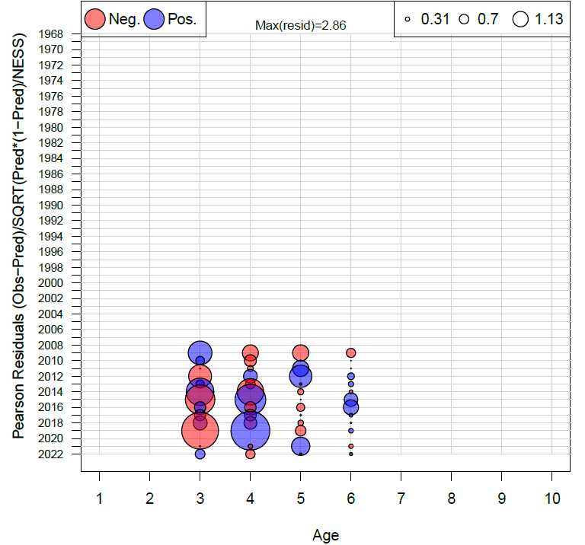
Bigelow age compositions
WHAM (OSA)
ASAP (Pearson)
Figure 20 WP 10

Slide 32
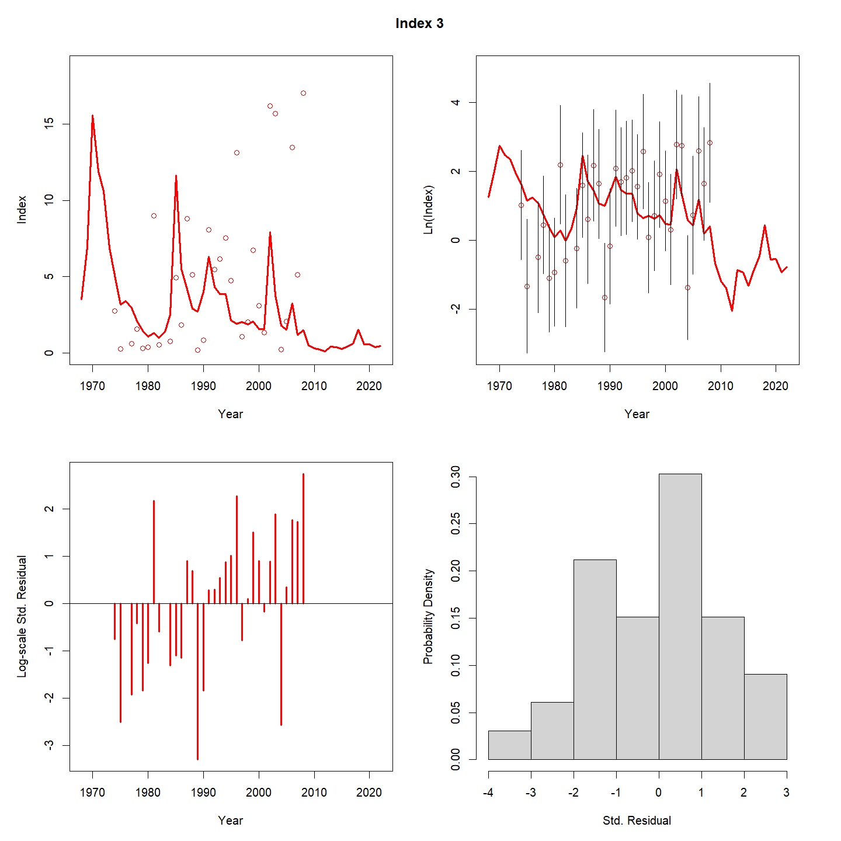
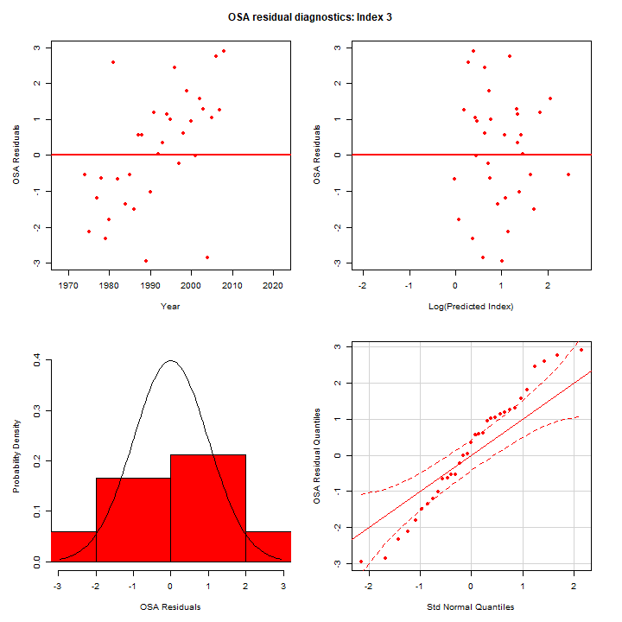
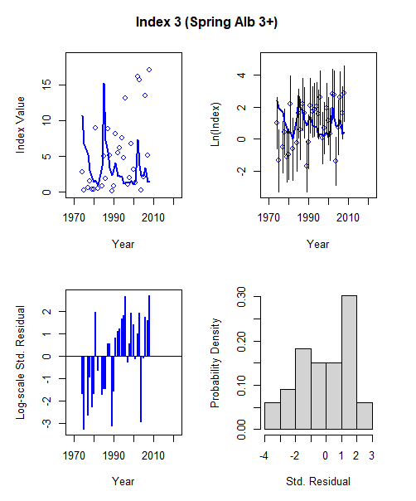
Albatross survey aggregate fit
WHAM
ASAP
Figure 17 WP 10

Slide 33
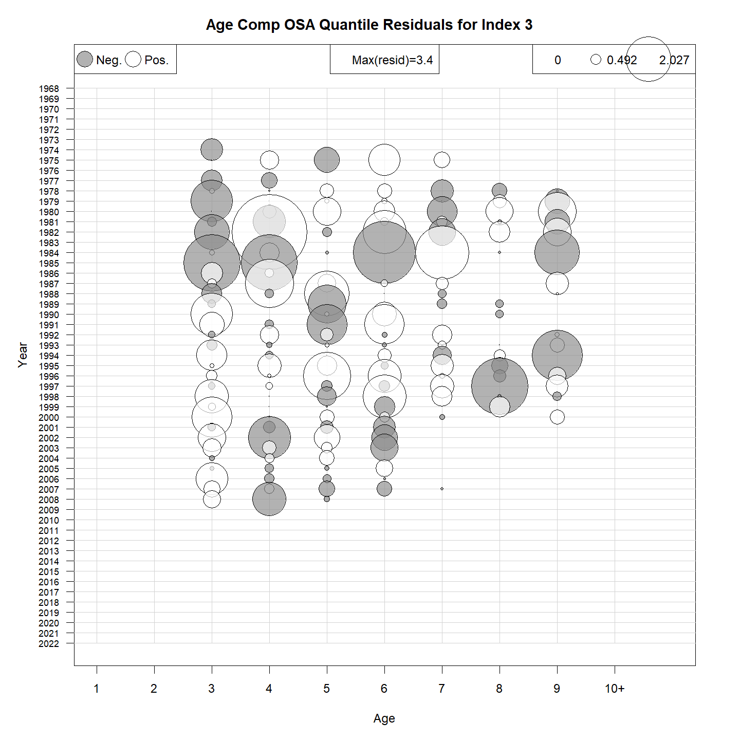
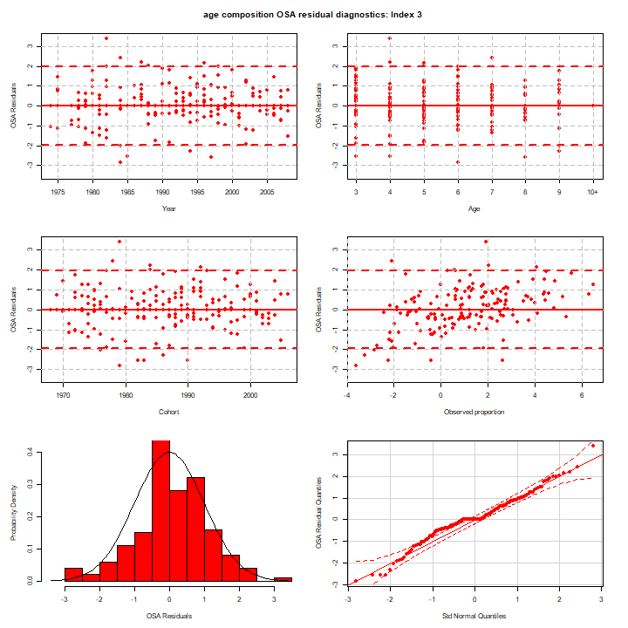
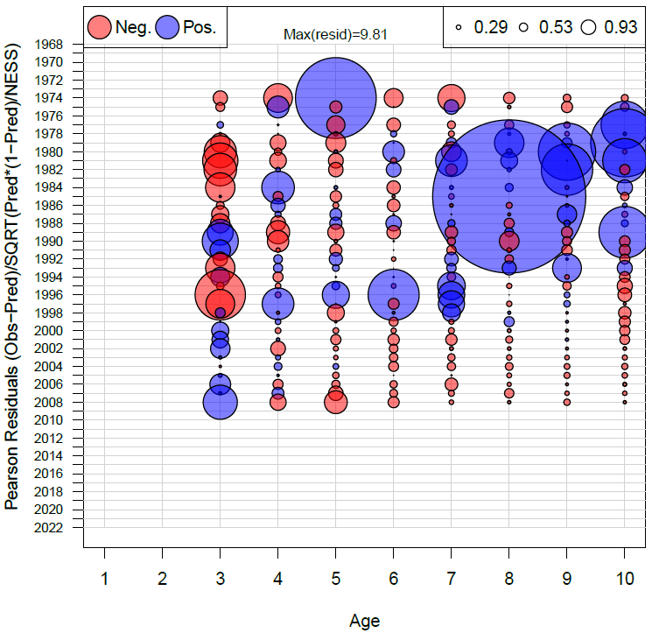
Albatross age compositions
WHAM (OSA)
ASAP (Pearson)
Figure 19 WP 10

Slide 34


Retro: SSB
ASAP
WHAM
ρ=0.281
Figure 21 WP 10

Slide 35


Retro: F
ASAP
WHAM
ρ= -0.162
Figure 21 WP 10

Slide 36

MASE
NEFSC Bigelow | Egg Survey
0.832 | 1.49
Table 5 WP 10
Figure 22 WP 10

Slide 37

Self-test
VAR | Mean Percent Bias
F | -0.71
R | 7.25
SSB | 5.67
Table 6 WP 10
Figure 23 WP 10

Slide 38
Diagnostic Summary
Similar fits to aggregate time series (though still strong patterning for Albatross time series)
Good fits to age comps
Retros are better in WHAM
Poor prediction skill for the egg survey
Passes self-test
Mohns rho
VAR | ASAP | WHAM
F | -0.306 | -0.162
SSB | 0.485 | 0.281
R | 0.132 | 0.251

Slide 39

ASAP to proposed WHAM model
ASAP
WHAM
Figure 25 WP 10

Slide 40
Future work
Exploration of high level of process error for numbers at age
Time varying survey catchability and fishery selectivity
(varying availability to NEFSC trawl survey and contributions of US and Canadian fisheries to total fishery catch)
Time-varying natural mortality
Recruitment

Slide 41

Biological reference points
M1 = ASAP
M2 = WHAM
 | ASAP | WHAM
F40% | 0.21 | 0.16
SSB40% | 154,107 (86,490 – 332,677) | 128,150 (49,587-331,184)
Yield40% | 30,460 (17,321 – 63,448) | 23,724 (9,123 – 61,693)
Table 7 WP 10
Figure 24 WP 10

Slide 42

Short-term projections
Year | Parameter | WHAM | ASAP
2023 | SSB | 56,696 (14,159-227,025) | 43,721 (17,764-100,647)
2024 | SSB | 79,974 (12,770-500,858) | 67,524 (32,341-143,307)
2025 | SSB | 87,139 (7,424-1,022,820) | 77,038 (43,184-156,933)
2026 | SSB | 83,319 (3,395-2,044,805) | 81,551 (47,719-176,672)
2023 | F | 0.08 (0.02-0.37) | 0.15 (0.07-0.34)
2024 | F | 0.16 (0.15-0.18) | 0.21 (0.21-0.21)
2025 | F | 0.16 (0.15-0.18) | 0.21 (0.21-0.21)
2026 | F | 0.16 (0.15-0.18) | 0.21 (0.21-0.21)
2023 | Catch | 5,953 (5,953-5,953) | 5,953 (5,953-5,953)
2024 | Catch | 15,429 (2,162-110,092) | 12,618 (6,127-27,331)
2025 | Catch | 16,285 (1,234-214,936) | 14,671 (8,301-30,242)
2026 | Catch | 15,422 (571-416,762) | 15,694 (9,268-33,414)
2023 | Rect | 131,200 (7,204-2,389,543) | 91,342 (28,584-294,287)
2024 | Rect | 115,979 (2,853-4,714,488) | 107,496 (29,362-405,817)
2025 | Rect | 102,721 (1,329-7,940,735) | 111,252 (29,651-470,921)
2026 | Rect | 91,150 (683-12,168,829) | 116,499 (29,937-524,124)
Figure 26 WP 10
Table 8 WP 10

Slide 43
Summary
Takeaways
Research recommendations
WHAM run:
logistic-normal-ar1-miss0 for fleet and surveys
2dar1 on NAA
WHAM had decent diagnostics
WHAM had improved retros
Minor differences BRPs and projections
Fixed effects WHAM replicates ASAP
Exploration of high level of process error for numbers at age
Time varying survey catchability and selectivity
Time varying natural mortality
Recruitment
Projection uncertainty

Slide 44
Back pocket slides

Slide 45
Asap-like WHAM run (fixed effects only)

Slide 46

Fishery catch: aggregate
WHAM
ASAP

Slide 47

Fishery catch: age compositions
WHAM
ASAP

Slide 48

Egg index
WHAM
ASAP

Slide 49

Albatross: aggregate
WHAM
ASAP

Slide 50

Albatross: age compositions
WHAM
ASAP

Slide 51

Bigelow: aggregate
WHAM
ASAP

Slide 52

Bigelow: age compositions
WHAM
ASAP

Slide 53


Retrospective
WHAM
ASAP
SSB
F
ρ= -0.306
ρ=0.485
ρ=0.281
ρ= -0.162

Slide 54


Historical retrospective
* 2009 TRAC did not pass peer review

Slide 55
Historical retrospective (2)
Diagnostic issues with both assessments prior to 2017
2009 TRAC did not pass peer review
2009: ‘05 model should not be used for management
Notes:
C:\Users\kiersten.curti\Desktop\Benchmark.2017\First.Year.1968\Run118.final.model.comparisons\Historical.retrospective.wmf

Slide 56
Figure 87
Historical retrospective
Diagnostic issues with both assessments
2009 TRAC did not pass peer review
2009: ‘05 model should not be used for management
Notes:
C:\Users\kiersten.curti\Desktop\Benchmark.2017\First.Year.1968\Run118.final.model.comparisons\Historical.retrospective.wmf

Slide 57
Figure 87
Historical retrospective
Diagnostic issues with both assessments
2009 TRAC did not pass peer review
2009: ‘05 model should not be used for management
Notes:
C:\Users\kiersten.curti\Desktop\Benchmark.2017\First.Year.1968\Run118.final.model.comparisons\Historical.retrospective.wmf

